Slide 1
Multi-Hazard Resilience Quantification for Civil Infrastructure Systems
Elise Miller-Hooks
University of Maryland
www.millerhooks.umd.edu
University of Maryland, October 22, 2014

Slide 2
Graduate Student Contributors
Graduated
Lisa Chen, Ph.D.
Rahul Nair, Ph.D.
Hakob Avetisyan, Ph.D.
Reza Faturechi, Ph.D.
Xiaodong Zhang, Ph.D.
Continuing
Mercedeh TariVerdi
Ali Asadabadi
Neza Vodopivec
Hossein Fotouhi
Kevin Denny (UG)

Slide 3
Two Components of Resilience
Inherent
Inherent capability to absorb or cushion effects of disaster via its topological and operational attributes
Adaptive
Potential cost-effective, immediate actions that can be taken to preserve or restore system’s ability to perform its intended function in disaster’s aftermath

Slide 4
3 Applications 3 Concepts
Intermodal Goods Transport (adaptability)
Airport Taxiway and Runway Systems (preparedness, adaptability)
Drivers – Roadway Travel Time (disaster life cycle)

Slide 5
Application 1: Intermodal Freight Transport
Maximize expected throughput over all scenarios
s.t.
Total flow along all paths cannot exceed demand
Links cannot support flows exceeding capacity
Budget constraint on recovery activities
Level-of-service constraint
At most one recovery action in each link
Binary and integrality constraints

Slide 6
Solution
(P) can be decomposed into a set of independent deterministic programs (P(x)), one for each realization, x
Each deterministic program represents an NP-hard problem containing a large number of variables
Proof by reduction from knapsack problem
Exact solution via
Benders decomposition
Column generation for subproblem solution
Monte Carlo simulation with spatial and temporal dependencies for generating scenarios

Slide 7
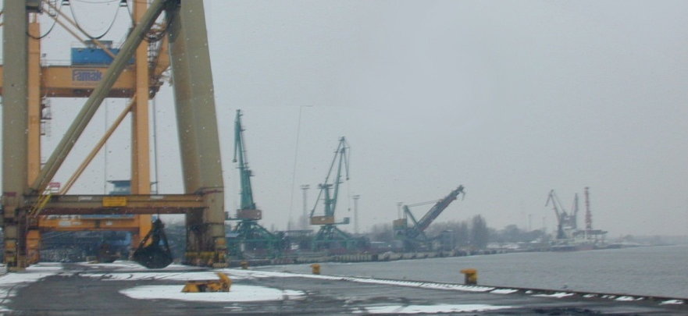
Port of Świnoujście, Poland
Focus on IM nodal facility
High proportion of cargo transit time is spent at nodal facilities
Bulk, container terminal and Ro/Ro operations

Slide 8
Port of Świnoujście, Poland
Sweden
Denmark
Rest of Europe
ferries
cargo ships
PORT
road and rail
Germany
(Berlin 140 km)
Poland
(Poznan 234 km)
(Wroclaw 371 km)
Czech Rep.
(Prague 533 km)
Slovakia
(Bratislava 783 km)

Slide 9
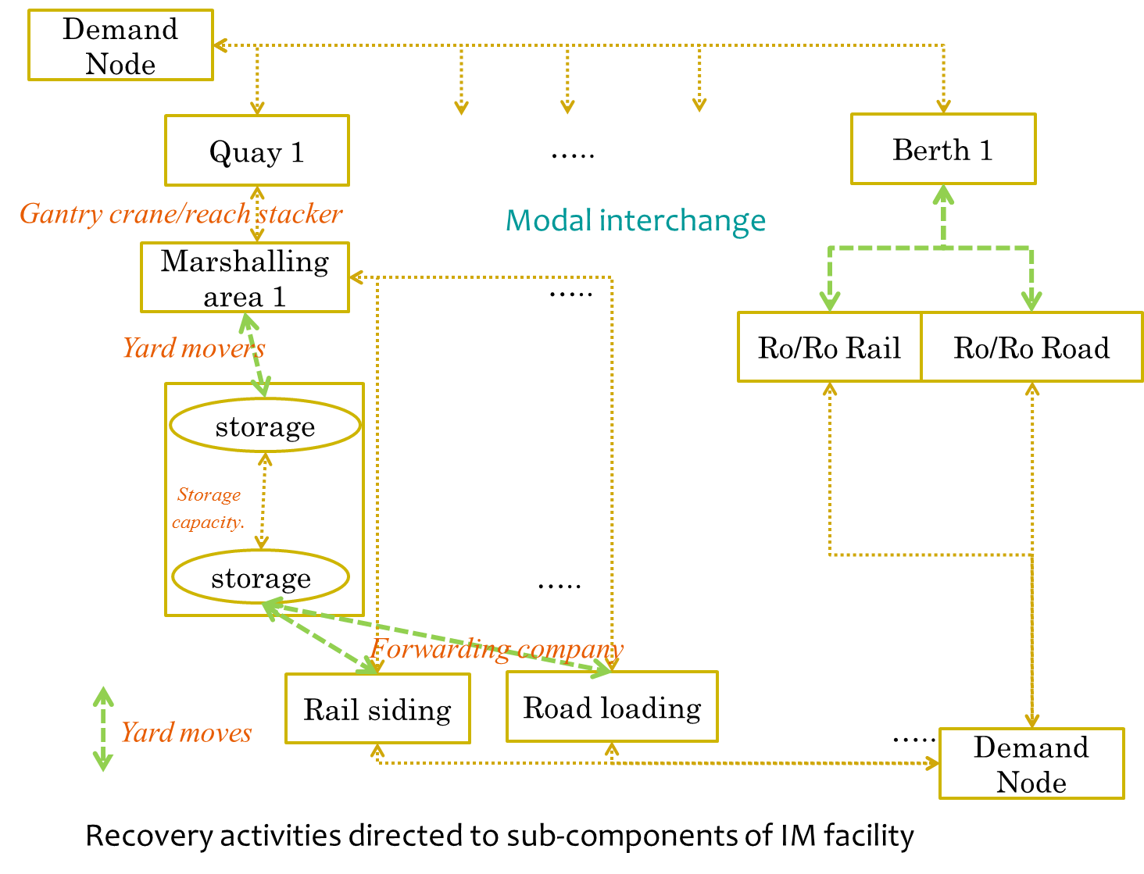

Slide 10
Network Representation
Physical infrastructure & processes
Processes = capacitated link

Slide 11
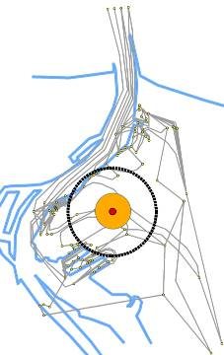
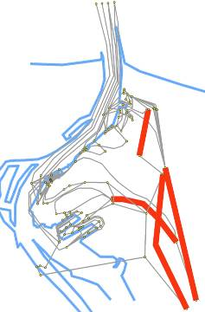
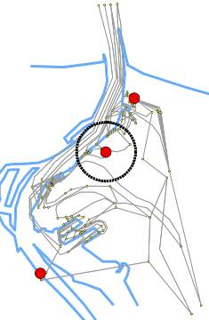
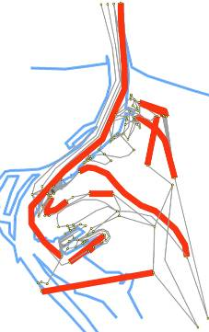
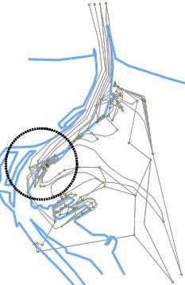
Disruption Scenarios
Scenario defined by location, intensity, and impact: uncertain
Disasters impact processes and reduce link capacities
Terrorism
(bomb)
Terrorism
(hinterland
access)
Terrorism
(coordinated/arson
-near chemical storage)
Earthquake
Local Flooding

Slide 12
Some Details
Additional Input
Recovery activities and their impact on various links and processes
Cargo flows through port
Computational Experiments
10,000 random realizations of disruptions and throughput measured
Network
10 O-D pairs
164 arcs, 390 paths
1261 recovery actions
Total =$76.6 million
Recovery budget
$0-$100,000

Slide 13
Results
Increase in resilience due solely to recovery actions
Budget ($) | Resilience level
0 | 77%*
10,000 | 87%
50,000 | 97%
100,000 | 99%
*Port services 77% of flows

Slide 14
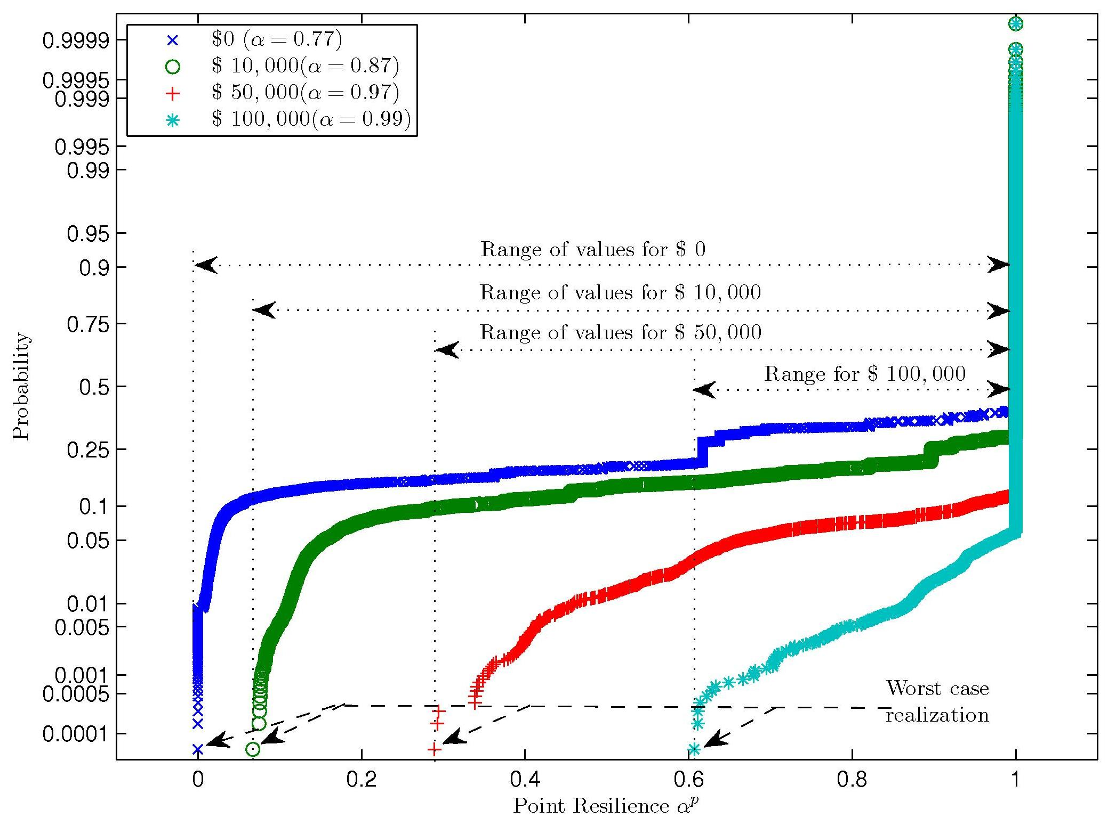
Point Resilience
The higher the budget, the narrower the range
Stabilization after ~2k realizations

Slide 15
Mitigation & Preparedness
Solution of (P) provides optimal recovery actions to take for monetary/time budgets
Can take preparedness steps to facilitate recovery:
Network expansion: e.g. add new link
Retrofit – harden network components for greater resistance
Order spare parts/backup equipment
Preposition resources to aid anticipated recovery activities
Implement technologies, training
Preparedness actions can enhance
inherent coping capacity
reduce time and cost of recovery actions

Slide 16
Maximizing Resilience
Maximize expected throughput
First stage:
At most one preparedness action in each link, binary d.v.
Second stage:
Maximize throughput in each scenario
Total flow along all paths cannot exceed demand
Budget constraint on preparedness and recovery activities
Links cannot support flows exceeding capacity
Level-of-service constraint
At most one recovery action in each link, integer/binary d.v.

Slide 17
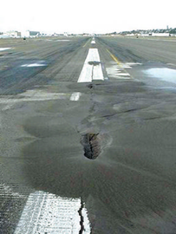
Application 2: Airport Taxiway & Runway Pavement Networks
Vulnerable to
extreme climatic/geological events
random operational events
natural deterioration
human-induced events
Major damage types (asphalt/ concrete)
cracking
disintegration
distortion
loss of skid resistance - increased surface slipperiness
Assess airport readiness to cope with damage

Slide 18
Airport Resilience
Expectation of total flow of all aircraft types and maneuvers
Total demand
System performance
Pre-event performance
Adaptive capacity
Post-response performance
coping capacity
Disaster moment
Time

Slide 19
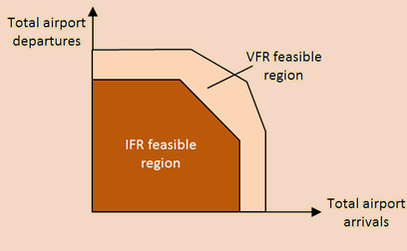
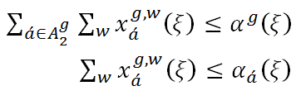
Airport Capacity Estimation
Runway capacity estimation
through capacity envelopes, boundaries of arrival and departure flows for each runway configuration (FAA 2004)
Runway configuration g:
Modeling parameters
Individual runway a’:
Flow of maneuver w in runway a’ for configuration g

Slide 20
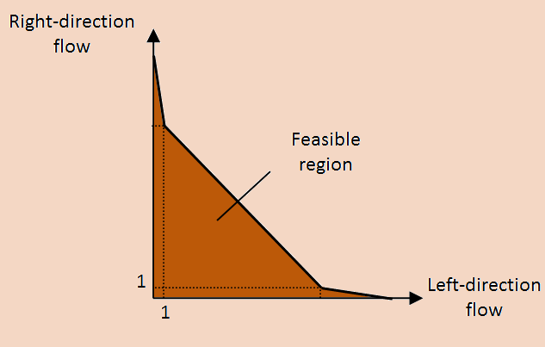
Airport Capacity Estimation
Taxiway capacity estimation
piecewise linear envelopes, boundaries of taxiway bi-directional flow (using piecewise linearization of Sherali, 2001)
Directional
taxiway flows
Convex-combination weights
Taxiway capacity

Slide 21
Minimum Operating Strip (MOS) Requirements
Runway segmentation to manage repair actions
Shortest set of consecutive functioning runway segments for safe landing and takeoff
Landing
1
2
3
4
5
6
7
Takeoff
1
2
3
4
5
6
7

Slide 22
MOS Requirements
Constraints to capture max functioning runway length given segment damage states and repair actions
Post-event damage state
4
3
2
1
Min takeoff length requirement
Post-response damage state
4
3
2
1

Slide 23
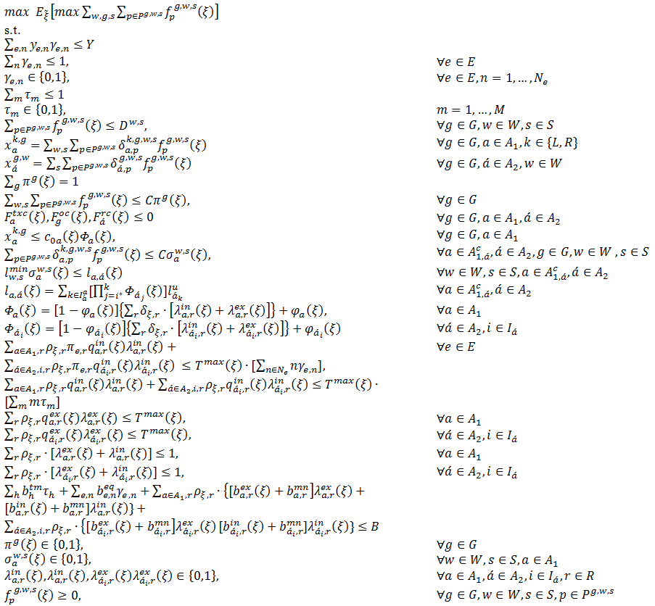
Optimization Model
Max. expected total arrival/departure flows over all ξ
1st stage decision
# and type of equipment to purchase
# of teams to train
2nd stage decision
Link/path flows (# of arrival/departure flights)
Runway configuration selection
Taxiway flow allowed if damage state equal to 1
Landing/takeoff min runway length requirements
Taxiway/runway post-repair damage state
Max allowed repair time
Repair actions with internal or external resources
Budgetary limitations
Non-negativity and integrality

Slide 24
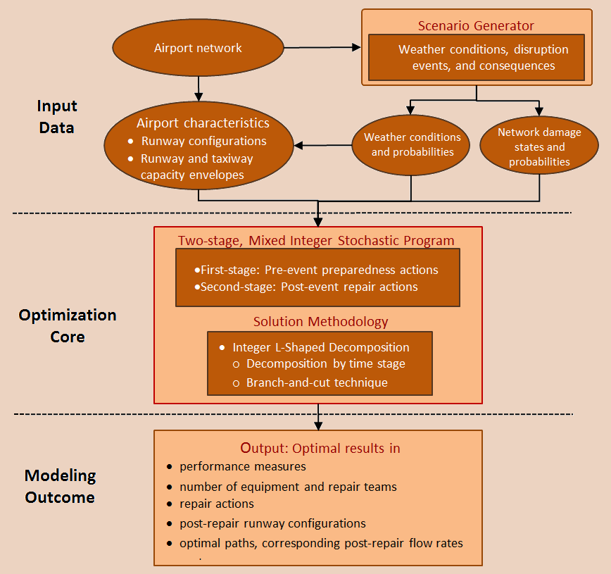
Envisioned DSS

Slide 25
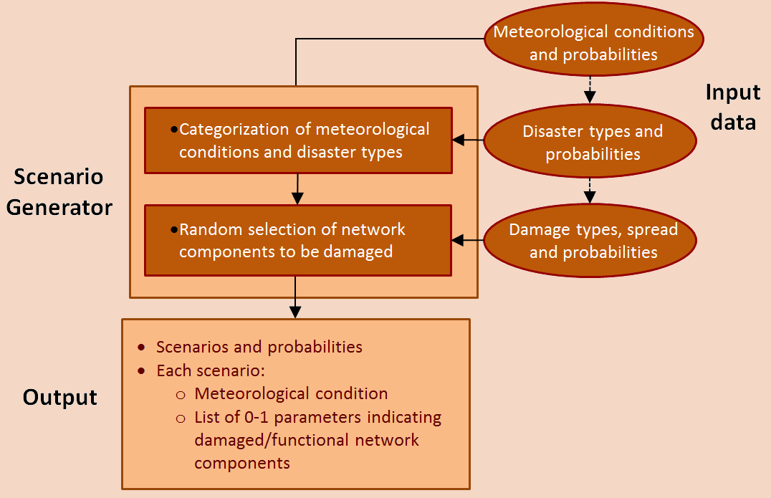
Modeling Input
Scenario generation
Identification of
repair action types
equipment requirements
implementation time & costs
external repair resources

Slide 26
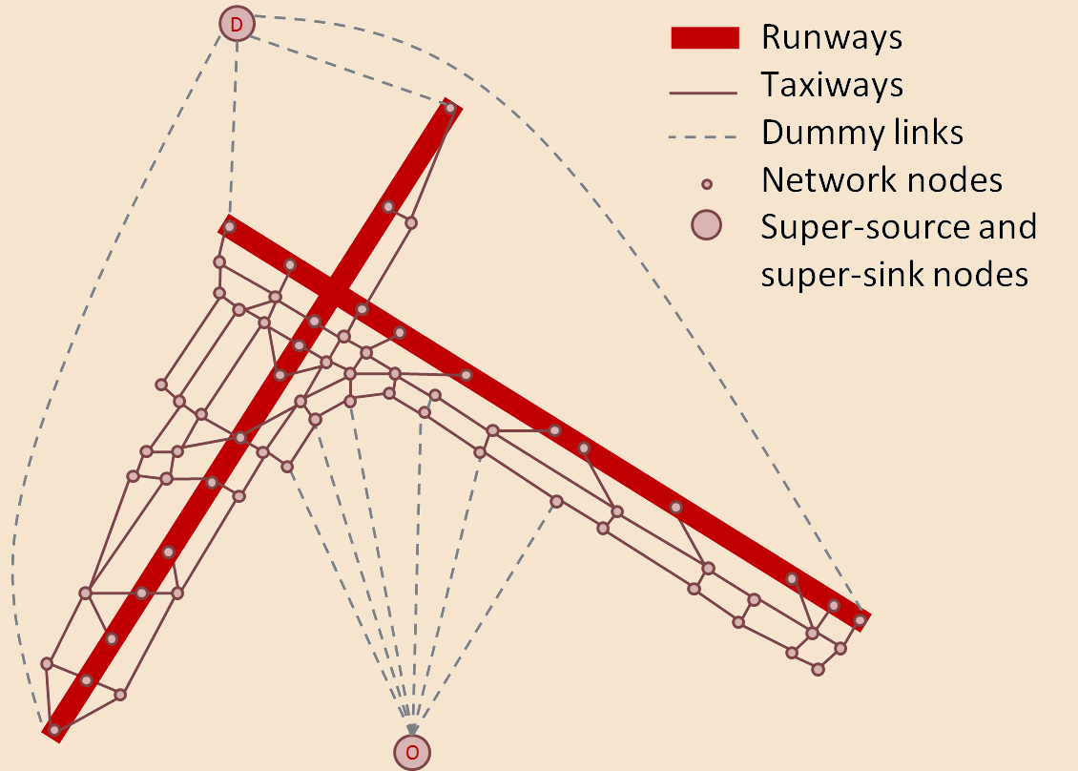
Illustrative Example
New York LaGuardia airport (LGA)
22
13
31
04

Slide 27
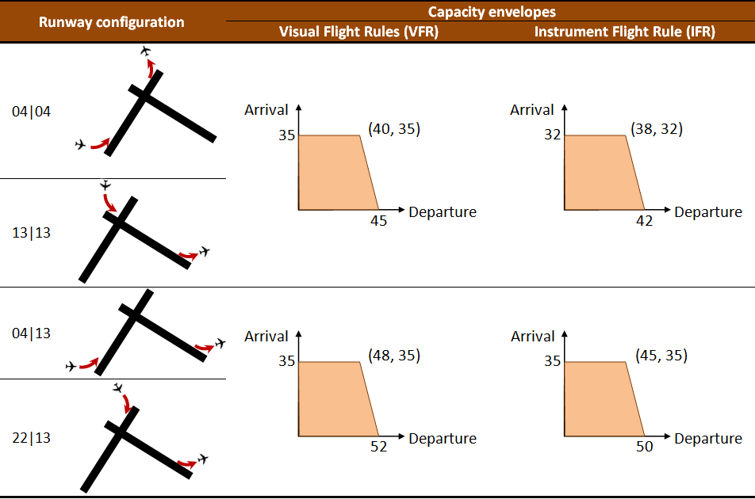
Optimization Model Input
Runway configurations

Slide 28
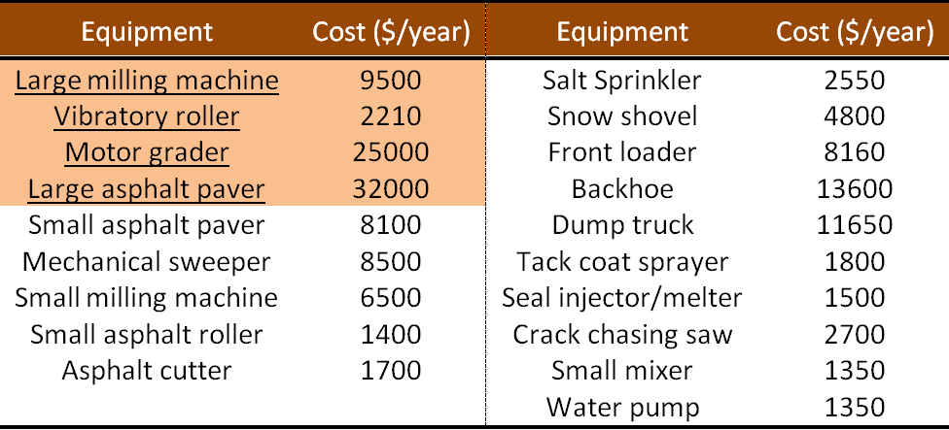
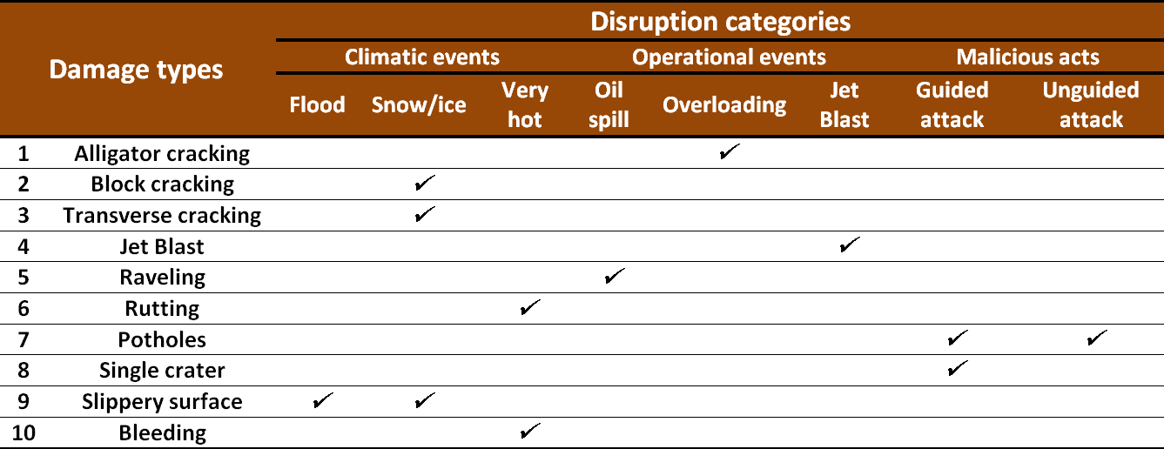
Optimization Model Input
Repair equipment list
Disruption types & possible consequences

Slide 29
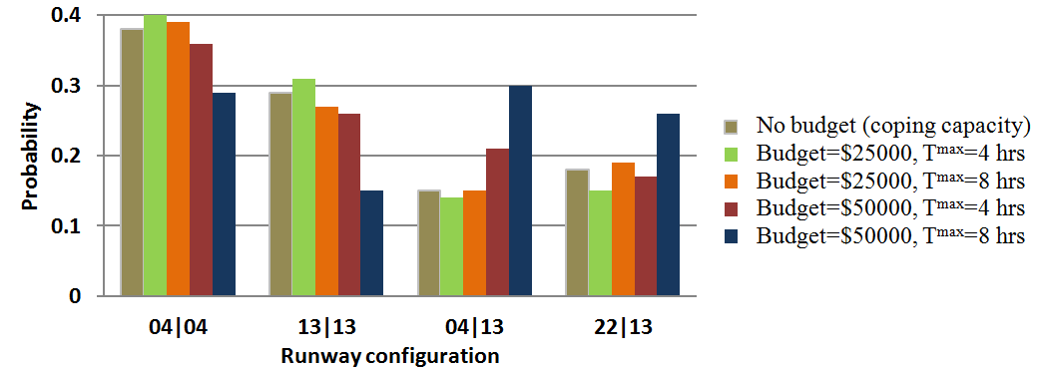
Modeling Results
Optimal budget allocation on internal/ external resources
Probability: runway configuration selection

Slide 30
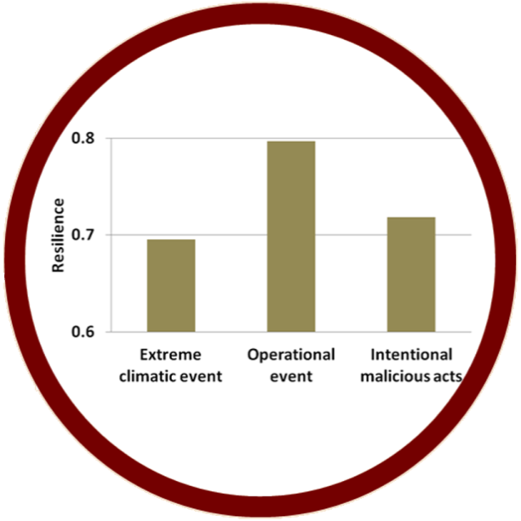
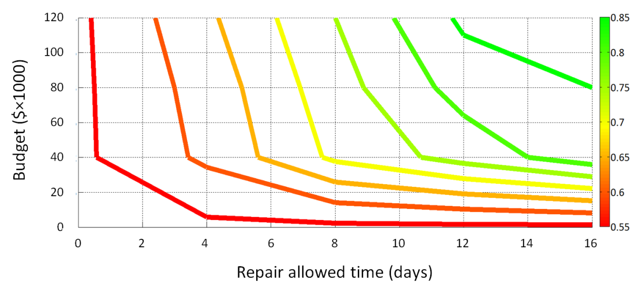
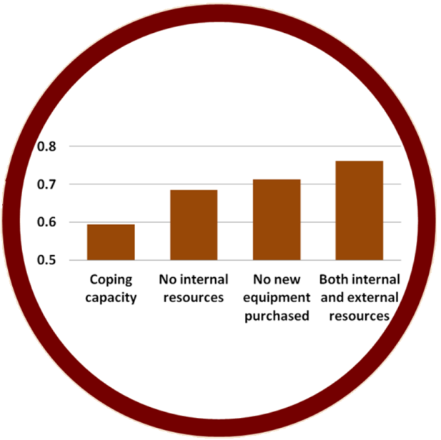
Modeling Results
Resilience indifference curves
0.75

Slide 31
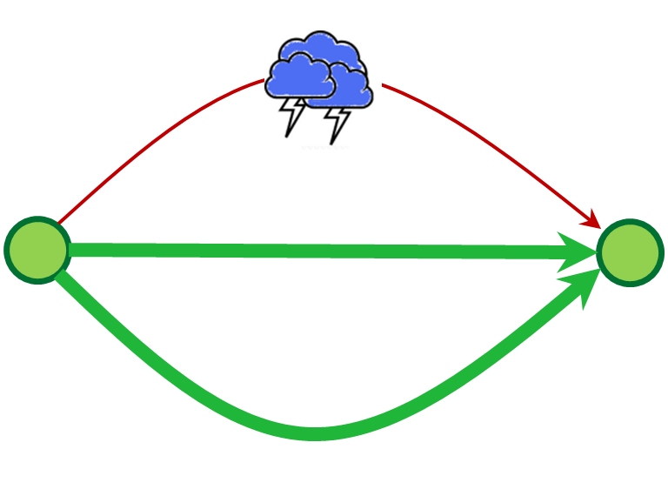
Application 3: Travel Time Resilience for Roadways
Travel time key in vehicular traffic
Challenge: how to model decentralized response of users to disruption?
Partial User-Equilibrium

Slide 32
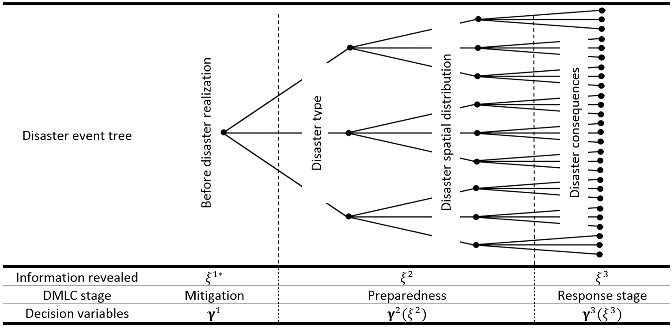
Information Evolution in Disaster
Disaster tree captures information evolution corresponding to decisions at each stage of the disaster life cycle

Slide 33
Travel Time Resilience Problem TTRP
Bilevel, three-stage, stochastic program with PUE constraints
Upper-Level (leader):
Uncertainty unfolds
Mitigation, preparedness and response actions identified/budgeted
Lower-Level (follower):
user response to UL decisions shortly after response stage, seeks PUE
Extension of stochastic network design problem (SNDP), formulated as SMPEC
Uncertainty in both levels
Stackelberg equilibrium at optimality

Slide 34
TTRP Formulation
Upper-Level:
Lower-Level (PUE):

Slide 35
Progressive Hedging Algorithm (PHA - Rockefeller and Wets 1991)
Nonanticipativity constraints
Address nonlinearities
Nonlinear, convex objective
Nonconvex constraints
TTRP transformed to single-level, 3-stage SMIP
KKT conditions
PHA
Lagrangian decomposition by scenario
Global optimality guaranteed
Non-anticipativity constraints added to force identical values over 3rd-stage information states

Slide 36
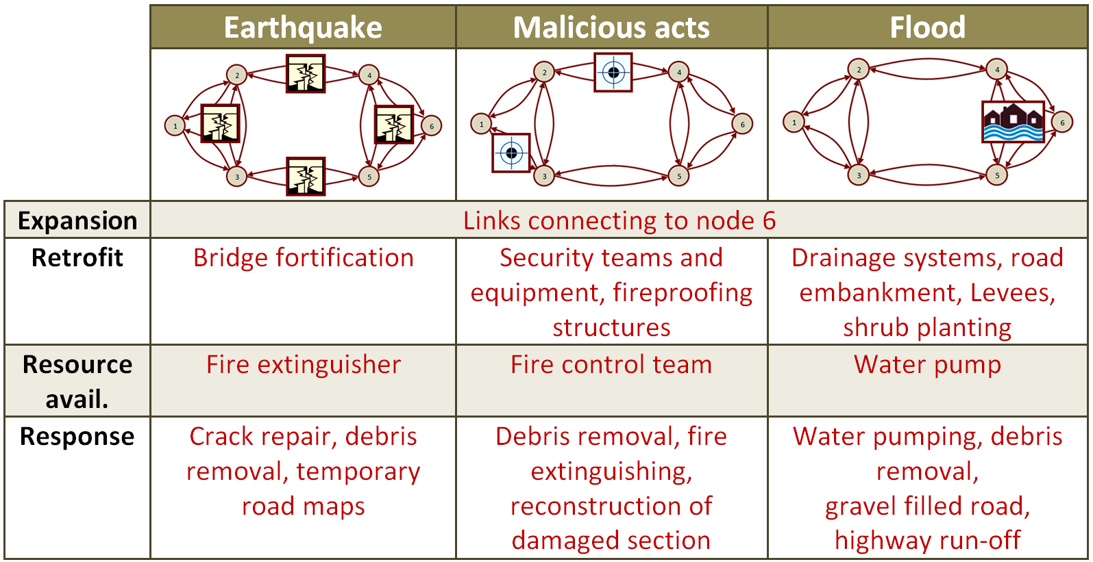
Numerical Application
90 multi-hazard scenarios

Slide 37
RIPS II: Interdependency and Civil Infrastructure Societal Systems

Slide 38
NSF RIPS II: Quantifying Disaster Resilience of Critical Infrastructure-based Societal Systems with Emergent Behavior and Dynamic Interdependencies
UMD-JHU-UDel

Slide 39
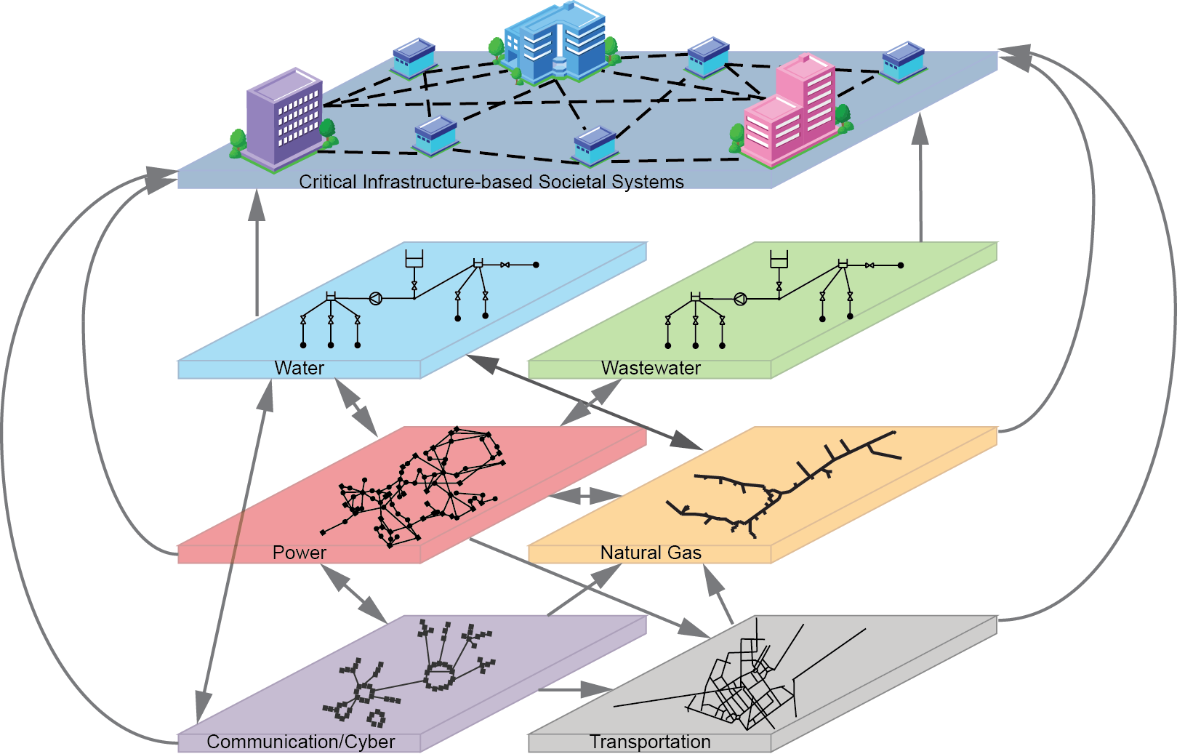
A Civil Infrastructure-based Societal System (CIbSS)
Comprised of interdependent buildings that together serve a community function
Is dependent on networks of critical lifelines
Family of structures linked by occupancy type, people, policies, information, location, services
Dependent on human, organizational, political, transportation and cyber links

Slide 40
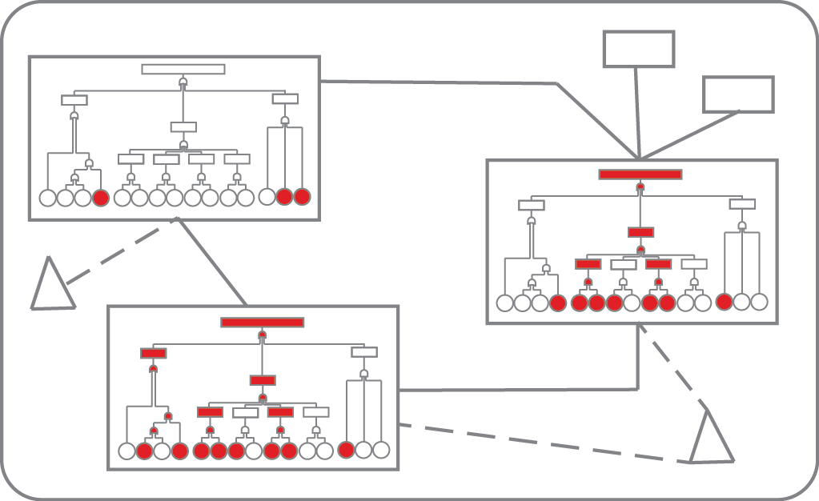
Lifelines Loss & Component Downtime Assessment Input to System Performance
(S,P)ς
single system state
Performance

Slide 41
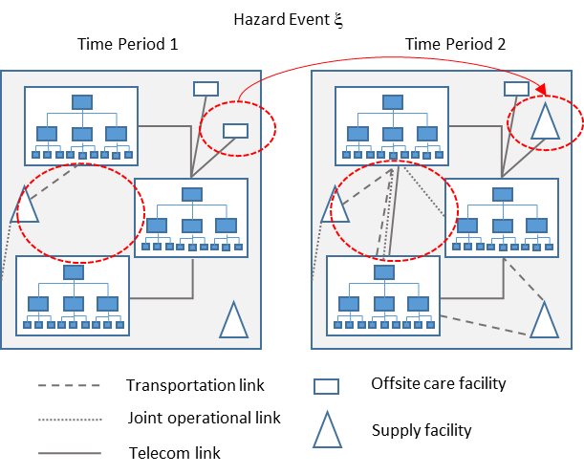
Interpret and model adaptive actions, emerging organizational behaviors, changing policies: dynamic interdependencies

Slide 42
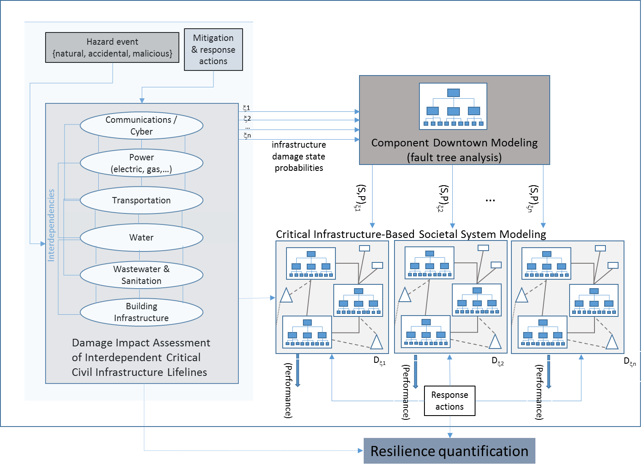
Solution Framework

Slide 43
Thank you
Peer-reviewed journal articles
Nair, R., H. Avetisyan and E. Miller-Hooks (2010). “Resilience of Ports, Terminals and Other Intermodal Components,” Transportation Research Record 2166, 54-65.
Chen, L. and E. Miller-Hooks (2012). “Resilience: An Indicator of Recovery Capability in Intermodal Freight Transport,” Transportation Science 46, 109-123.
Miller-Hooks, E., X. Zhang and R. Faturechi (2012). “Measuring and Maximizing Resilience of Freight Transportation Networks,” Computers and Operations Research 39(7), 1633–1643.
Faturechi, R. and E. Miller-Hooks (2014). “Disaster Resilience in Civil Infrastructure Systems: Quantification and Optimization,” Computer-Aided Civil and Infrastructure Engineering Systems 29, 572-589.
Faturechi, R., E. Levenberg and E. Miller-Hooks (2014). “Evaluating and Optimizing Resilience of Airport Pavement Networks,” Computers and Operations Research 43, 335–348.
Faturechi, R. and E. Miller-Hooks (2014). “Travel Time Resilience of Roadway Networks under Disaster,” Transportation Research Part B 70, 47-64.
Faturechi, R. and E. Miller-Hooks (in press). “A Comprehensive Review of the Literature on Disaster Performance Analysis of Transportation Systems,” in press in the ASCE Journal of Infrastructure Systems (available on-line).
Zhang, X. and E. Miller-Hooks (in press). “Scheduling Short-Term Recovery Activities to Maximize Transportation Network Resilience,” ASCE Journal of Computing in Civil Engineering.
Zhang, X., E. Miller-Hooks and K. Denny (in review). “The Role of Network Topology in Resilience of Transportation Systems,” in second round of reviews for publication in Journal of Transport Geography.

