Slide 1
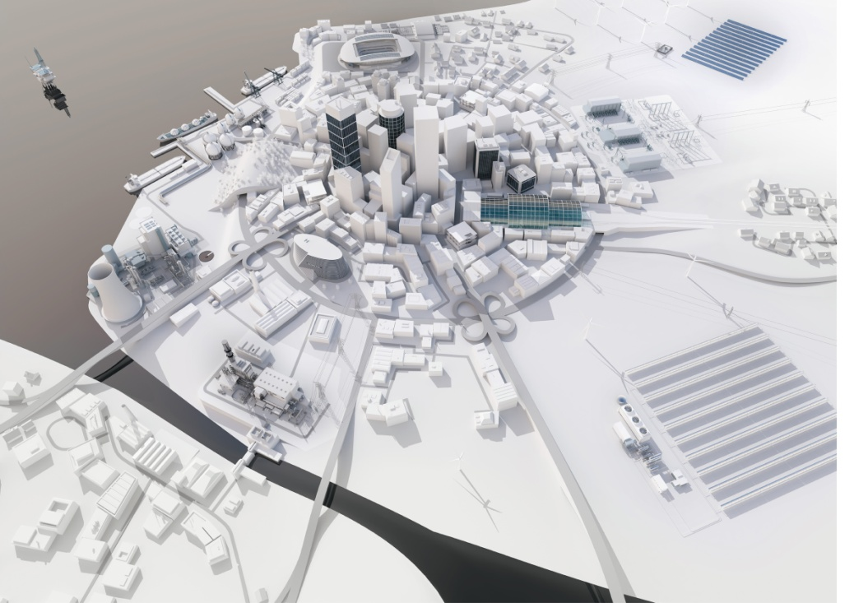
Energy Solutions for Grid Resilience in an Evolving Climate
University of Maryland
October 20, 2014
Ken Geisler
Vice President, Strategy
Smart Grid Software & Services North America
Energy Management Division
Siemens

Slide 2
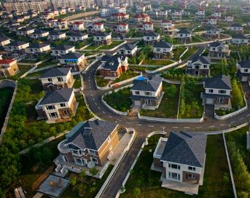
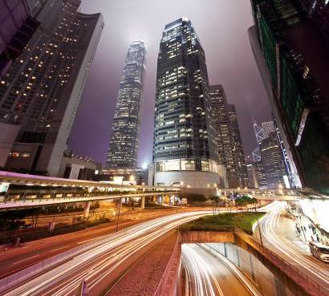
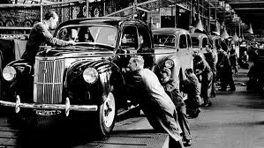
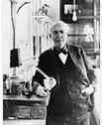
Evolution of the Energy Grid
1900
1950
1980
2020
“Re-urbanization” of cities is changing the way we work and live and has the potential to bring awareness, education, and responsibility to energy use
Grids are required to power the sprawling growth of suburbanization
Rural Electrification and continued Industrialization
Thomas Edison develops the first electric systems
Page 2
Notes:
2

Slide 3
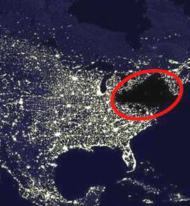
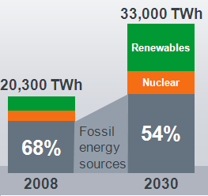
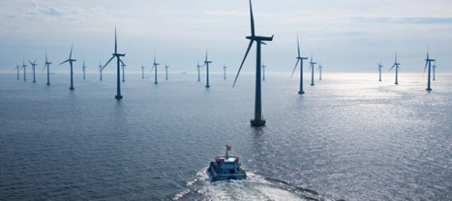
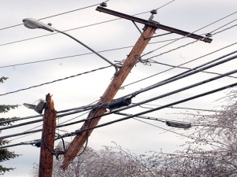
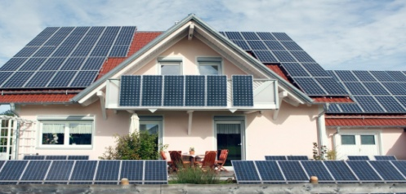
The Changing Needs of the Energy Delivery Grid…
Increasing Energy Demand
Security Concerns & Regulation
By 2030, power consumption will grow to roughly 33,000 TWh - a 63 percent leap!
7 Million people without power during 2012 Hurricane Sandy and billions in damage
Renewable Energy Adoption
Aging Infrastructure & Electrical Loss
In 2011, renewable sources of energy accounted for about 9.3% of total U.S. energy consumption and 12.7% of electricity generation
Today, in the U.S. power grid: 70% of transformers and 60% of switchgear are over 25 years old
Page 3
Source:US Energy Information Administration, Institute for Energy Research
Notes:
3

Slide 4
Weather patterns are becoming more extreme, mostly due to climate change…. resilient grids!
250
Floods
  Climate change leads to higher temperatures, rising sea levels and more rainfall
  Increasing number of extreme weather events
  Increasing urbanization and settlement patterns lead to higher damages
  2012: US$ 160 bn damage worldwide (67% in USA)
Storms
200
Earthquakes
Droughts
Regression lines
150
100
50
0
1970
1980
1990
2000
2010
Figure 1: Number of recorded disasters
Source: EMDAT-CRED, Brussels
Page 4
10/19/2014
IC CC
Notes:
Memo 4

Slide 5
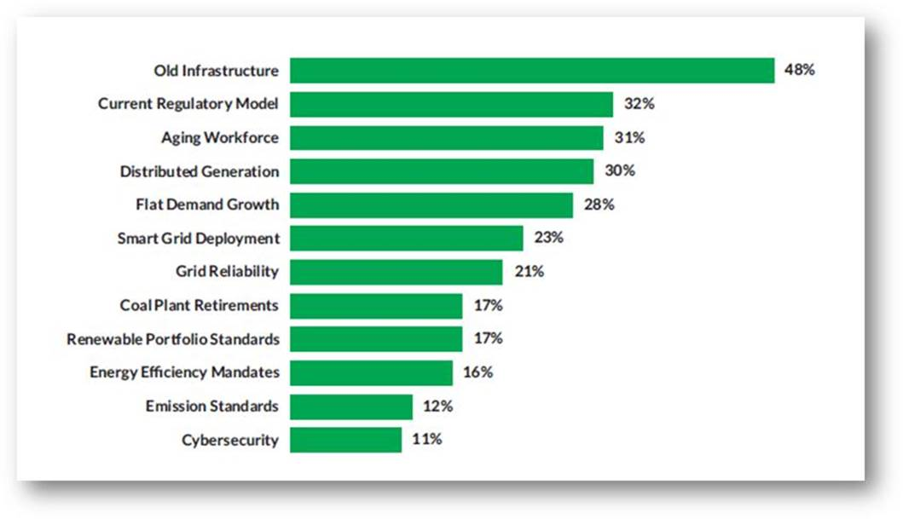
The State of the Utility Market
Key Challenges identified by sampling of 527 IOU/Muni/Coops
Key Value Propositions
Resilience
Sustainability
Efficiency
Reliability
Source: Utility Dive, The State of the Electric Utility, February 2014

Slide 6
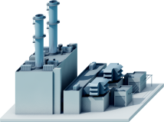
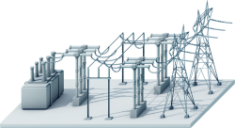
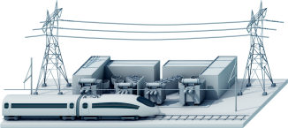
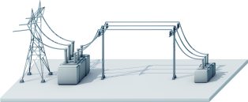

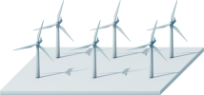



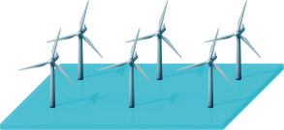

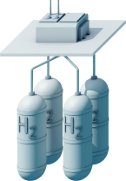




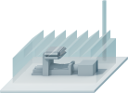




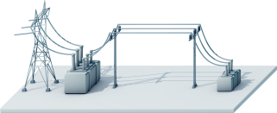

Decentralization of grid design
From centralized, unidirectional grid …
… to distributed energy and bidirectional energy balancing
Hydrogen Storage
Diesel Generator
Biogas CHP
Offshore Wind Parks
Private Solar
Small Industrial
Gas Turbine
Pumped Storage
Power Plant
Storage
Solutions
Storage
Solutions
Electrical
Vehicles
Smart Street
Lighting
Large Scale
PV Plant
Unidirectional Power Flow
Bidirectional Power Flow
Page 6
Notes:
6

Slide 7
Grid capabilities and applied technologies
Grid Capability | Characteristics | Applied Technologies
Resilience | Decentralized Design, Firm Local Generation, Multi-utility Integration, Critical Infrastructure Support | Decentralized Gas/Digester Generation, Combined Heat and Power, Micro-grids, Community Storage, Integrated Building/Rail/Water/Public Safety, Community Logistics Notification/Coordination
Sustainability | Variable Local Resources, Energy Use Follows Available Generation, Two-way Flow of Energy | Integration of Variable Renewable Resources, Demand Management, Distributed Energy Resource Management, Facility/Campus Storage
Efficiency | Active Grid , Visibility, Automate Outage Response, Streamline Operations | Distribution Management, Substation Automation, Feeder Automation, Adaptive Protection, Voltage Management, AMI/Smart Metering, Social Media Reporting/Assessment
Reliability | Passive grid, One-way Distribution of Power, Reactive Problem Response | Centralized Generation, Radial Distribution, Reactive Trouble Dispatch and Outage Management
Generally Outside Regulated Utility Business Model
Generally Within Regulated Utility Business Model
Notes:
Layers of grid capability need to be built up and supported. Starts from current infrastructure reliability designs and centralized approach.
Efficiency is a large focus for most energy utilities. More automation, more sensors, faster location of problems, greater knowledge of delivery network conditions.
Efficiency and reliability generally within existing utility business models and budgets.
Sustainability brings in other stakeholders. Outside control and management of the utility but potentially significant impacts on the distribution grid. Suggests modifications in utility business model to account for design changes and shorter term investments. Some “modernization” could be funded by efficiency gains. First stages of decentralization forced by consumers reducing bills and becoming producers of energy. Not “dispatched” by utility, but obligation to serve when not there. Economies for consumer but difficult for utility participation.
Resilience again increases stakeholders to take a community view, identify “critical” infrastructure, support with firm local generation, islanding capabilities, grid resynchronization, and coordinated utility dispatch/operations.

Slide 8
Phased approach towards energy resilience and sustainability
In evaluating the options, we pursue three different levels of energy resiliency and sustainability which includes:
Facility – At the most granular level, we have identified individual facilities for economy improvements and secure supply through on-site generation.
Campus – Next, there are adjacent facilities that can be connected, local generation can be installed, and can be managed as a “campus” microgrid without using the local utility equipment or violating the utility franchise.
Community – Finally, there are facilities that can be connected through, and coordinated with, the local utility, incorporating extended critical infrastructure (gas stations, designated “safe areas”, hospitals, etc.), and be managed as a microgrid.
Increasing stakeholder involvement with options – Differences in generation sizing and degree of automation and coordination between phases.
Win for Community, City, State, Utility, and Vendors

Slide 9
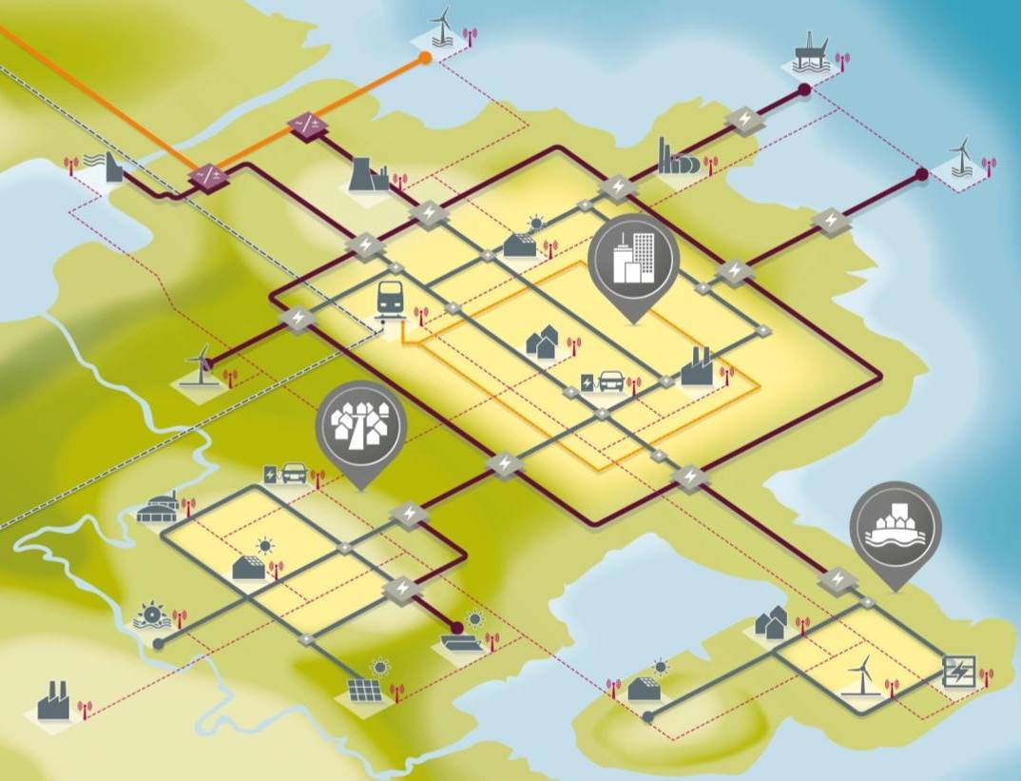
Thank you for your attention
Ken Geisler
Vice President, Strategy NA
Smart Grid Software & Services
Energy Management Division
Siemens
E-mail:
ken.geisler@siemens.com
Answers for infrastructure and cities.

