Slide 1


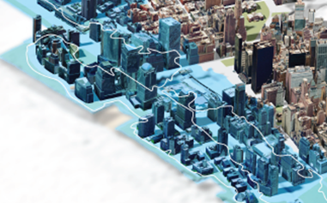
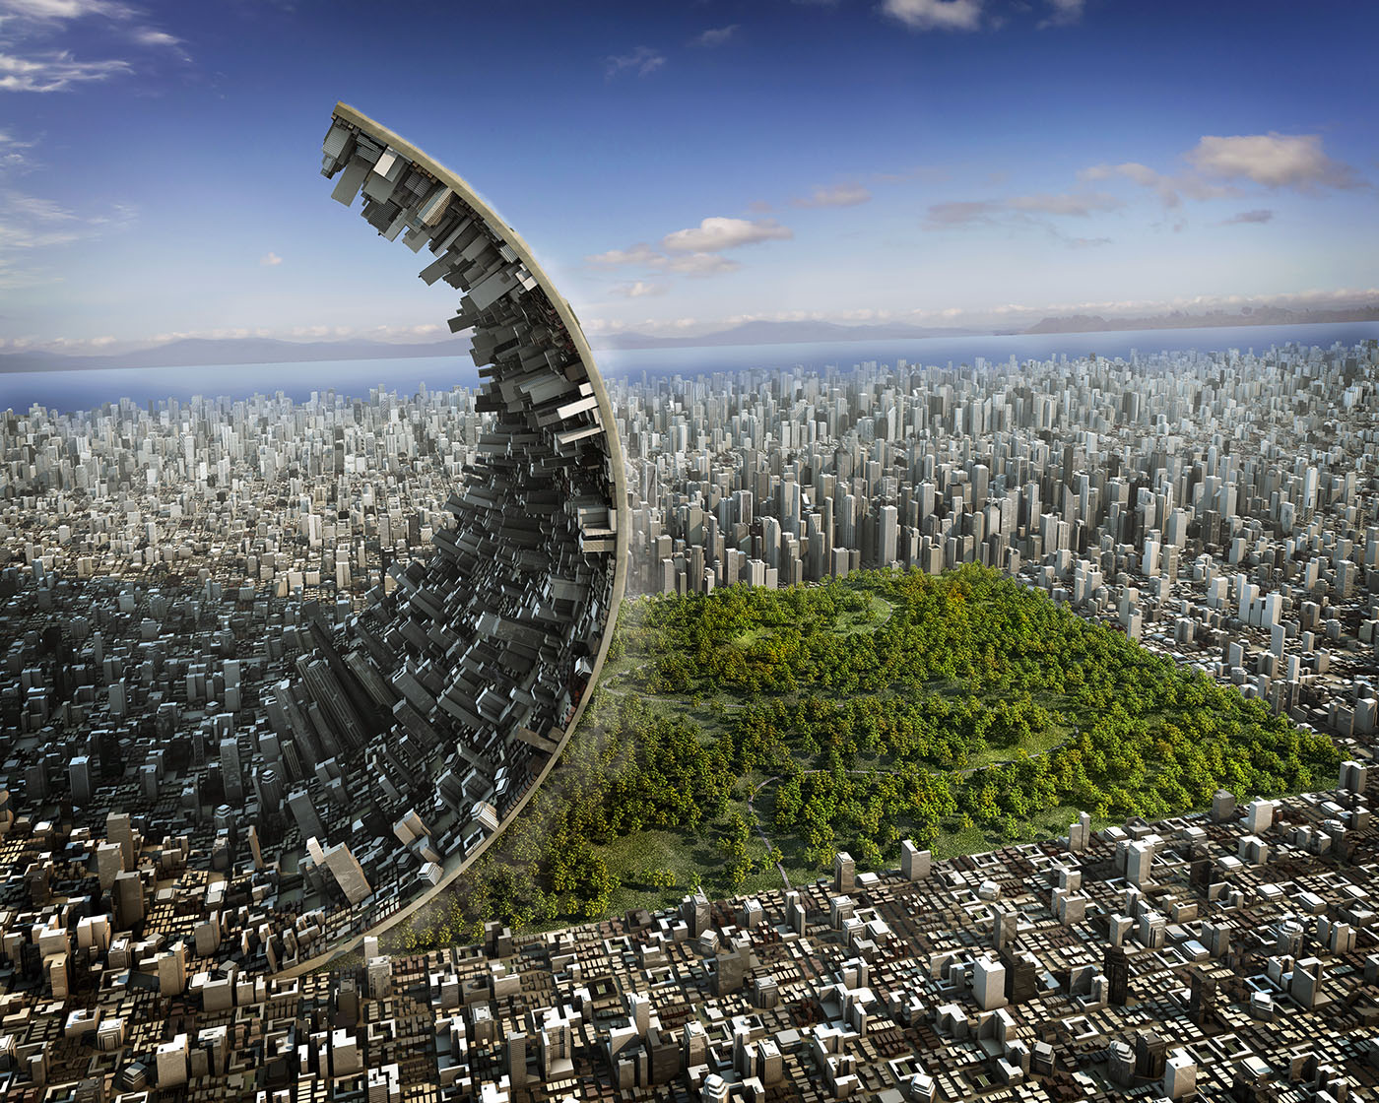

Adapting to Change:
Managing Risk and Uncertainty for Resilience and Disaster
Preparation
University of Maryland
MG John Peabody, P.E.
Deputy Commanding General, Civil & Emergency Operations
U.S. Army Corps of Engineers
22 October 2014
US Army Corps of Engineers
BUILDING STRONG®
Notes:
Thanks, on behalf of our Chief of Egineers LTG Tom Bostick, for inviting me here to talk about resilience communities, with a special emphasis on water resources.
It’s always nice to have a change of pace, and today’s talk gives me an opportunity to look at resilience communities in a new and different way. I’m going to bring in some concepts that are not cast in concrete, but represent new thinking about urban climate resilience.

Slide 2
USACE CW’s Economic Benefits & Revenues to the Treasury
(2010-2012 Average)
Each dollar spent on the USACE Civil Works program generated
~ $16 in economic benefits and $5 in revenues to the U.S. Treasury.
Program | NED Benefits (Billions of Dollars) | Net NED Benefits (Billions of Dollars) | U.S. Treasury Revenues (Billions of Dollars)
Flood Risk Management | $59.47 | $58.84 | $18.90
Coastal Navigation | $9.47 | $8.70 | $3.70
Inland Navigation | $8.10 | $7.51 | $2.07
Water Supply | $7.00 | $6.98 | $0.09
Hydropower | $2.30 | $2.11 | $1.37
Recreation | $3.20 | $2.91 | $1.13
Leases and Sales |  |  | $0.03
Total Annual NED | $89.54 | $87.05 | $27.29
Notes:
Net NED benefits are defined as NED benefits less the costs of operations, maintenance, and investigations. Since the costs associated with expenses and oversight by the Assistant Secretary of the Army (ASA) serve all Corps programs, including those we did not calculate benefits for in this report, this report does not account for those costs.".
The Benefits and Revenues numbers are not additive.
Notes:
Contributions to National Economic Benefits (NED) are increases in the value of the national output of goods and services, expressed in monetary units.
Treasury revenues are the net increases in revenues in the form of increased tax payments and direct payments for vendible outputs (such as hydropower) that accrue to the U.S. Treasury as a result of the USACE Civil Works programs.
It is estimated that the USACE Civil Works program provides a total net NED annual benefit of approximately $48.9 billion. In addition, the USACE Civil Works program stimulated about $14.8 billion in returns to the US Treasury.
In summary, in FY2010, for each dollar spent on the USACE Civil Works program, approximately $9 in economic benefits to the nation were generated and $2.70 in US Treasury revenues were generated. The rate of return for the USACE Civil Works program is estimated to be 26%.

Slide 3
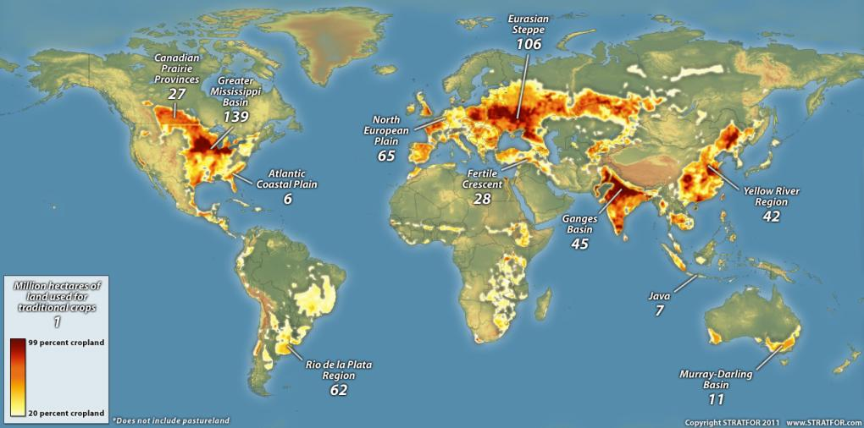
The United States:
The Inevitable Empire?
Notes:
The STRATFOR article is a summary reasoning for the compelling need to invest in this nation’s water resources infrastructure, particularly our inland waterway system, and our ports and harbors.
This article summarizes the geographically-based reasons for the rise and dominance of the United States as “The Inevitable Empire”. Most notably, it highlights the primary reasons for that as the nation’s extensive navigable waterway system in its interior, and the associated plenitude of natural resources (from agriculture to coal) that this extensively drained interior facilitates for transportation and commerce.
The article posits five main compelling “geographic imperatives” that the United States has (and must) follow to sustain its dominance over its interior and exterior influences:
1. Dominate the Greater Mississippi Basin;
2. Eliminate Land based Threats to the Greater Miss. Basin;
3. Control Ocean Approaches to North America;
4. Control the World’s Oceans;
5. Prevent Potential Challengers from Rising
This view point strongly reinforces many of the Corps’ main themes in recent times. WE are a maritime nation, and the ability to leverage our extensive interior navigable waterway system – the most extensive such system in the entire world – is essential to our economic advantages and geopolitical dominance. Further, it is the entire Mississippi Basin watershed that forms the basis for America’s successful economic development and geopolitical global supremacy, which is then furthered via our exterior ports, harbors, and sea approaches.

Slide 4
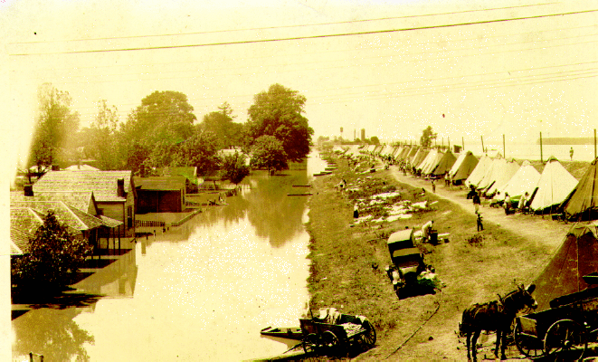
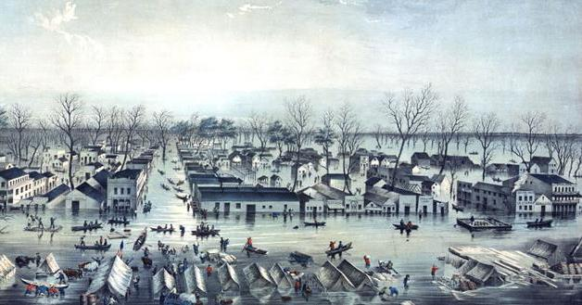
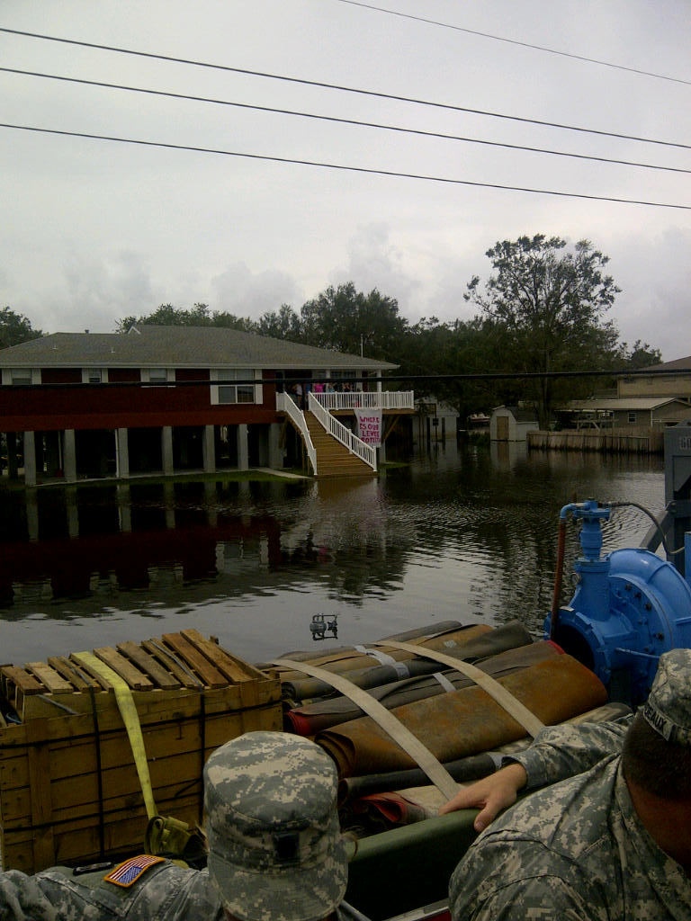
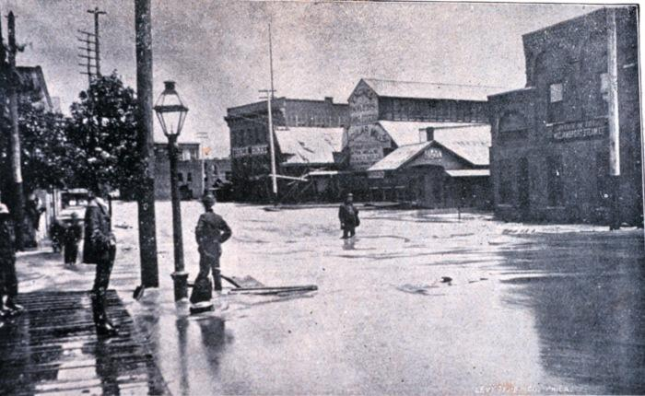
Flood Risk is an Enduring Reality in American History …
4
Notes:
When we talk about resilience, we often do so in the context of floods and the ability of communities to withstand them and bounce back.

Slide 5
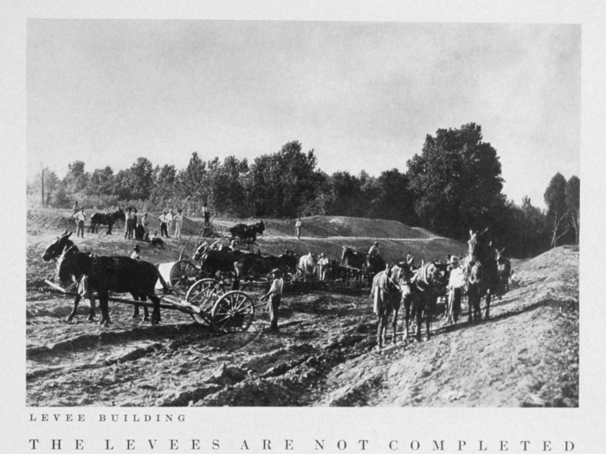
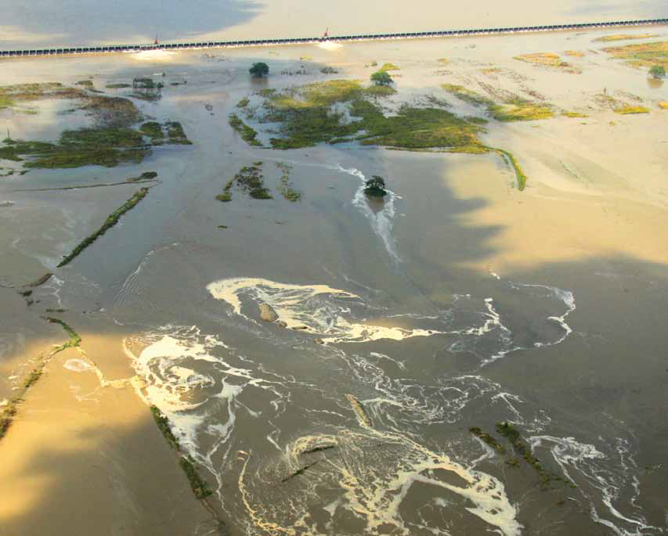
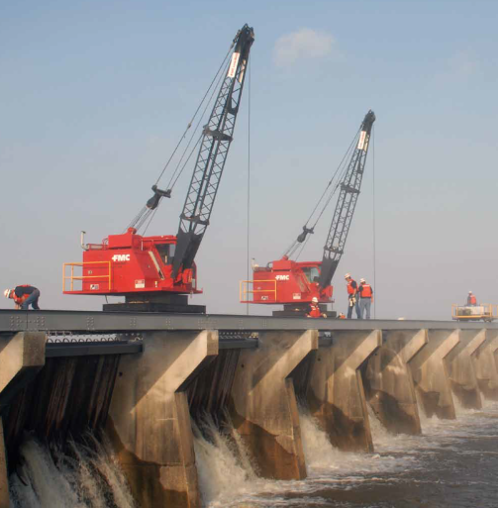
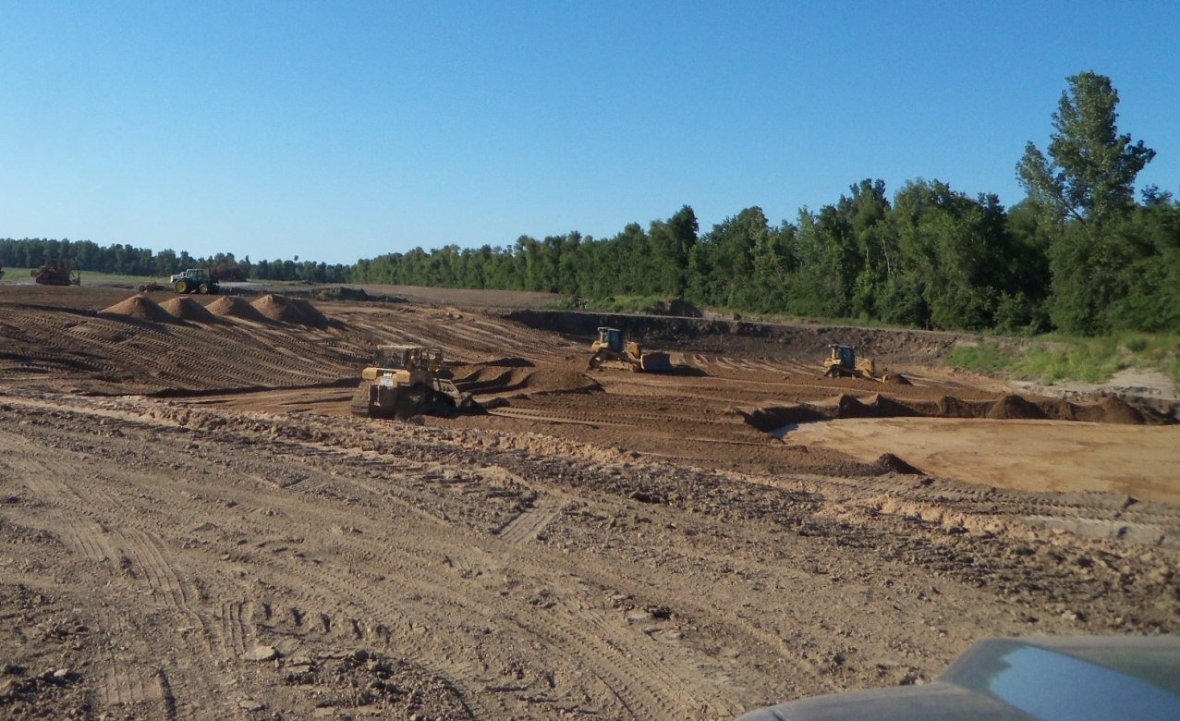
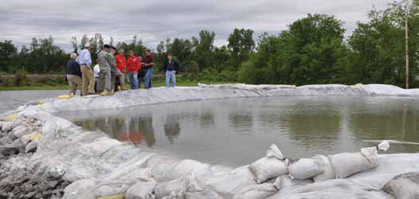
… and Americans Have Persistently Tried to “Control” Floods
5
Notes:
In the organization I represent, the U.S. Army Corps of Engineers, our earliest water-related mission was improving our waterways and ports; but we also had an early interest in flood risk management. The levee systems still in use in St. Louis were designed in 1837 by a Corps of Engineers lieutenant – Robert E. Lee.

Slide 6
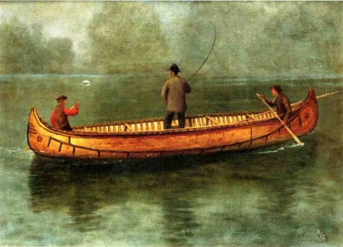
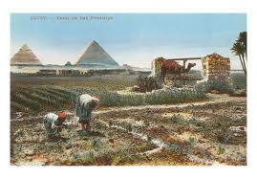
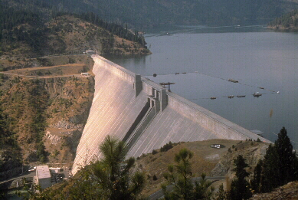
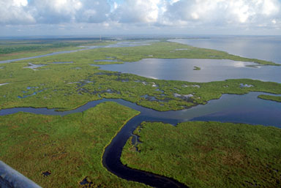
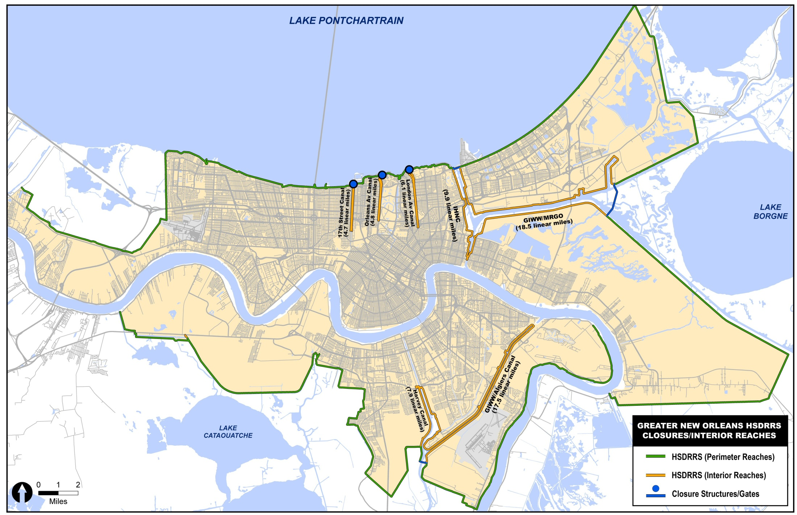
Live with floods
Individuals and small communities adapt to nature’s rhythm.
Utilize the Flood Plain
Fertile flood plain land drained for agriculture.
Permanent communities develop in floodplains.
Control Floods
Large-scale structural approaches implemented through organized governance.
Reduce Flood Damages
Recognition that engineering has limitations.
Effort to increase the resilience in the event of a flood
Manage risk
Not all problems are equal.
Risk Mgmt is an effective & efficient means to maximize benefits of Flood Risk investments.
Evolution of Approaches in
Managing Flood Risk
From Sayers et al , 2012
6

Slide 7

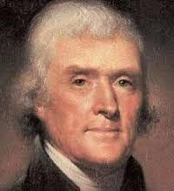
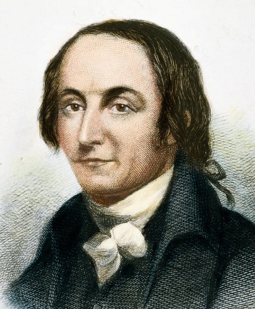
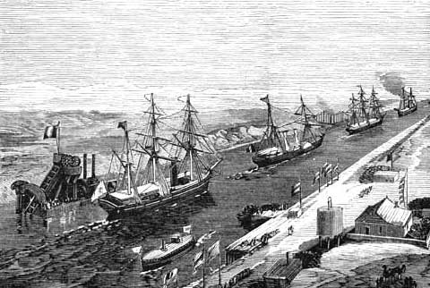
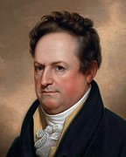
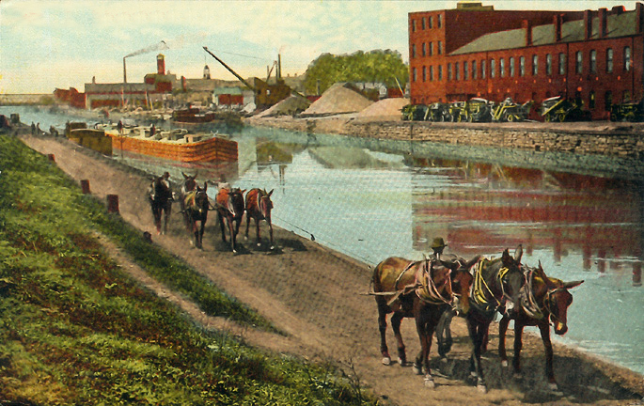
1a) Nation Building: Starting the Task
Analysis
1808 Gallatin Report
Key Legislation
1826 Omnibus Rivers and Harbors Act
Institutions Formed
1802 US Army Corps of Engineers
1871 US Commission on Fish and Fisheries
1879 Mississippi River Commission
Key Events
Westward expansion - Value of navigation: interior river systems
1817 Start construction of the Erie Canal
1828 Start Construction of the Chesapeake and Ohio Canal
Notes:
Summary from “The Evolution of Water Resource Planning and Decision-Making (Russell and Baumann 2009)
George Washington
Thomas Jefferson -

Slide 8
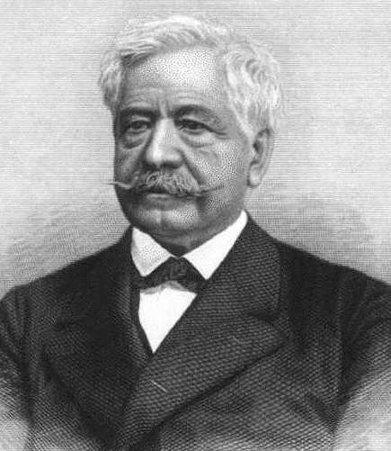
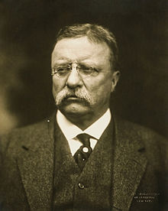
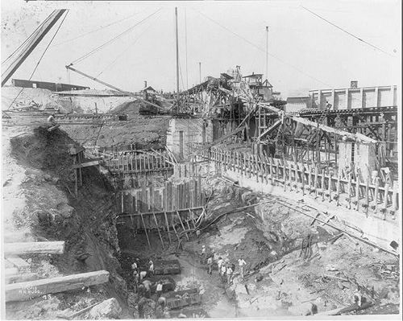
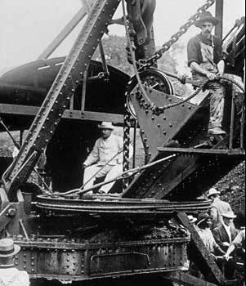
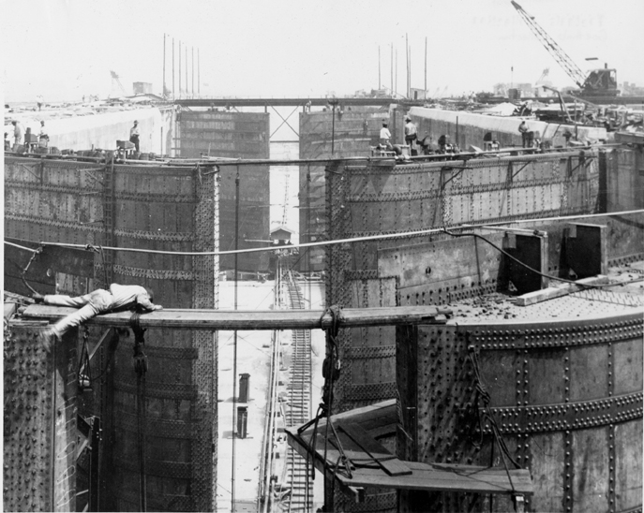
1b) Nation Building: Completing the Phase
Key Legislation
1902 Reclamation Act
1917 Flood Control Act (first)
1920 Federal Water Power Act
1927 Rivers and Harbors Act
1928 Boulder Canyon Project Act
Institutions Formed
1902 Reclamation Service
1905 National Forest Service
1909 National Conservation Cmsn
1912 National Waterways Commission
1916 National Park Service
1920 Federal Power Commission
Key Events
1914 Panama Canal completed
1927 Great Mississippi River Flood
Notes:
Summary from “The Evolution of Water Resource Planning and Decision-Making (Russell and Baumann 2009)
Ferdinand de Lesseps
Panama canal
Roosevelt operating crane during canal construction
Canal lock under construction

Slide 9
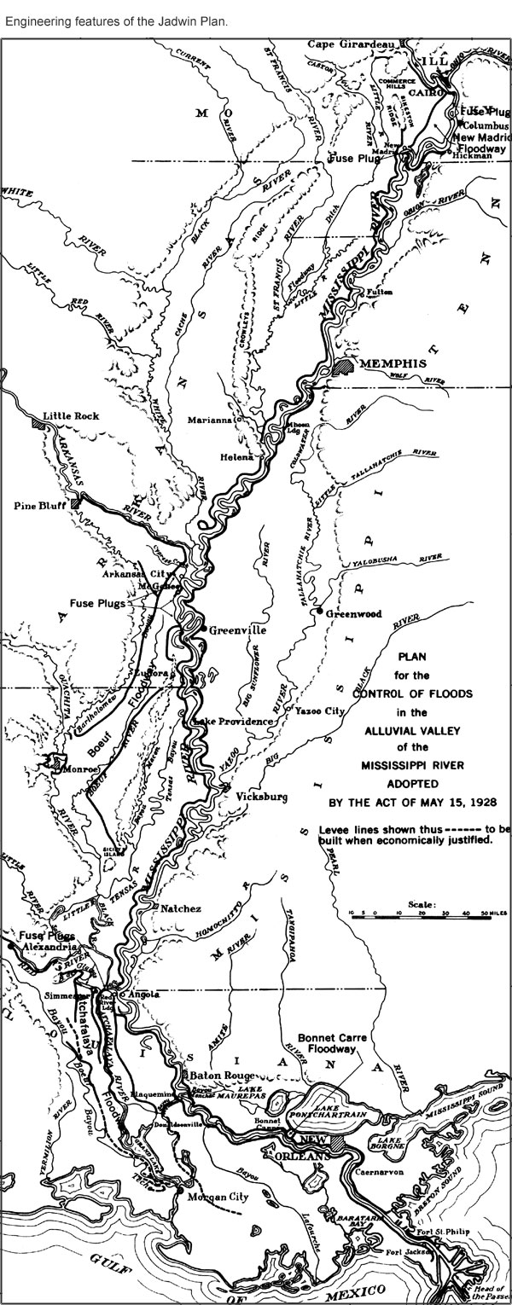
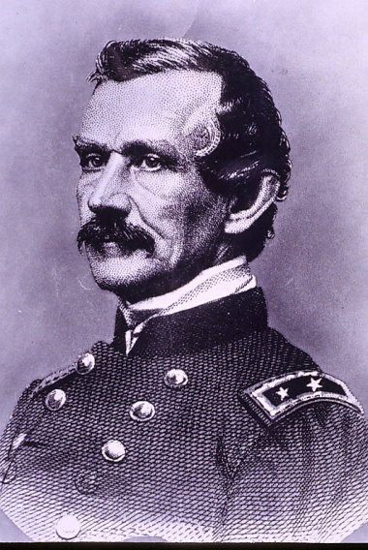
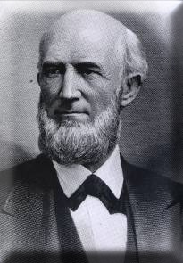
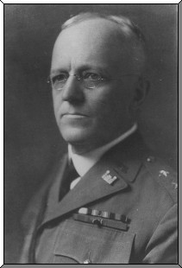
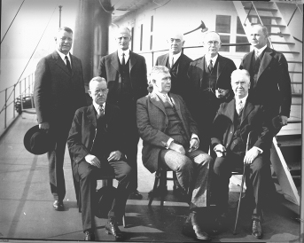
Mississippi River Debates
Humphreys v Ellet (1852-1866)
Framed in larger context of military v civilian engineering instruction
Levees & natural outlets v levees, reservoirs & artificial/natural outlets
1866 Humphreys becomes Chief Delta Survey becomes dogma within Corps; reservoirs, outlets and cutoffs championed by private sector
Humphreys v Eads (1874-1879)
Canal v Jetty system to open mouth of Mississippi River
1879 Eads prevails; MRC created to give private sector greater voice.
Cutoffs to Lower Flood Stages (1884-1932)
Prominent engineers propose cutoffs to lower flood stages, but MRC/Corps stand opposed.
1932 Congressional Resolution authorizes cutoffs; 16 cutoffs executed by 1945. Cutoffs still lower stages in 2011
Jadwin v Mississippi River Commission (1927-1945)
Jadwin = smaller levees, large uncontrolled floodways (outlets), no reservoirs; MRC = higher levees, smaller controlled floodways,
further study on reservoirs
1928 FCA authorized Jadwin Plan; modified by
to include controlled floodway at Morganza and reservoirs
Notes:
Round 1 - Ellet vs Humphreys: Plans of Improvement (1851-1866)
-Ellet favored improved levees supplemented by headwater reservoirs and artificial outlets/enlarged natural outlets; Humphreys favored general levee system augmented by unimproved outlets (Humphreys becomes Chief; Delta Survey becomes dogma)
Round 2 - Eads vs Humphreys: Opening the Mouth of Miss River (1874-1879)
-Eads favored jetty system in the passes; Humphreys favored Fort St. Philip Canal as a bypass (Jettyites win out, success leads to belief in extreme confinement of river; Humphreys retires as the Miss River Commission is established)
Round 3 - Cutoffs to lower flood stages (1890-1927)
-MRC/Corps both oppose cutoffs as detrimental to the river; civilian engineering community (John Coleman, John Millis, Elam) advance various cutoff proposals (cutoffs prevented until 1929. Large scaled cutoff program implemented in 1930s and 1940s to lower flood stages . Benefits still felt during 2011 flood.
Round 4 - Jadwin vs Miss. River Commission
Jadwin favored smaller levees, large uncontrolled floodways, one spillway to protect New Orleans, no reservoirs. MRC favored higher levees, smaller (and fewer) controlled or gated floodways, and dual spillways to protect New Orleans, further study on reservoirs. (Jadwin plan adopted in 1928 FCA, but modified by 1936 Overton Act to include MRC proposed features.

Slide 10
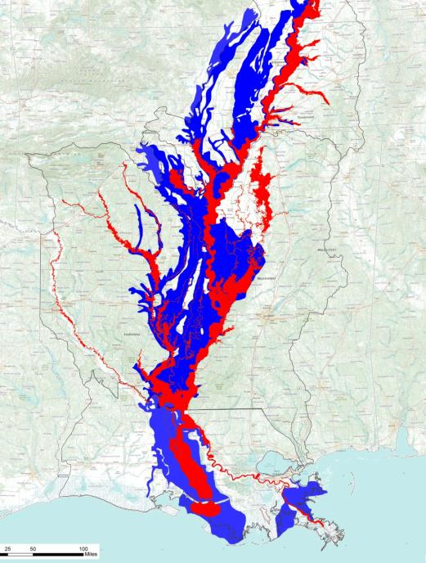
1927 vs. 2011 Mississippi River Record Flood:
From “Levees Only” to “Room for the River”
1927 Flood = 16.8 M acres (Challenge)
2011 Flood = 6.35 M acres (Response)
$230 B damages prevented - $612 B since 1928 - 44 to 1 ROI
$7 B in crop damages prevented
4.5 million people protected
$3B Annual Transportation Rate Savings
2011
1927
Notes:
1. Industrial activity the valley:
In an economic base study directed by USGS for the Lower Mississippi River Corridor Counties, manufacturing revenue was estimated to be $87 billion (2001 price levels) and accounted for 383,000 jobs.
2. Economic activity that's enabled due to the MR&T project:
In the same study USGS estimated the total economic activity to be $128 billion (2001 price levels) and accounted for 771,000 jobs.
10

Slide 11
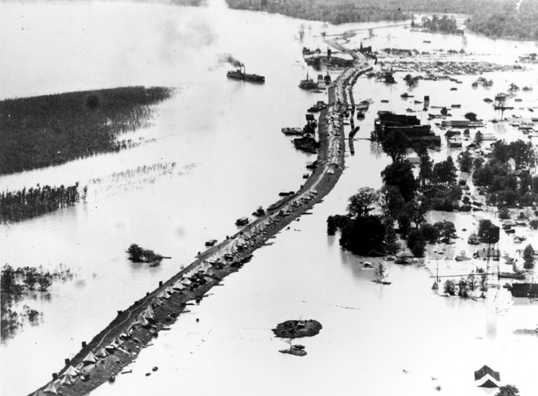
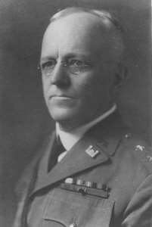
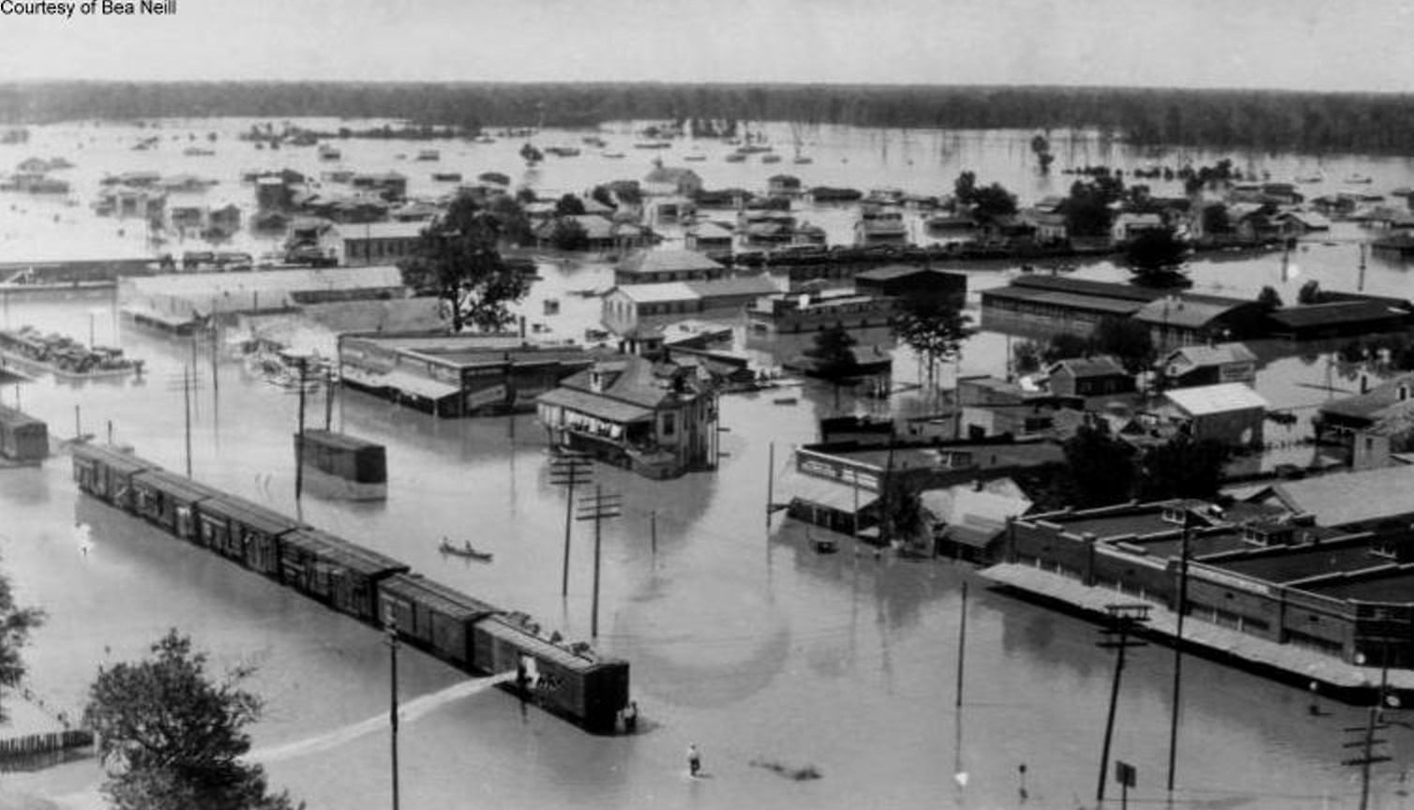
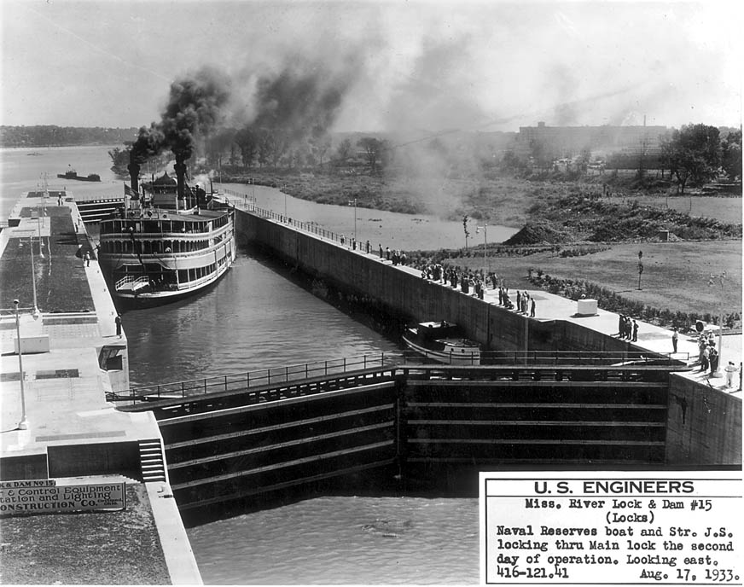
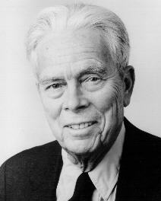
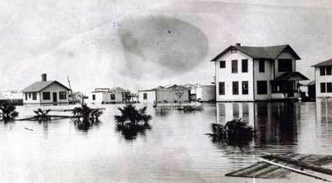
2a) Economic Efficiency: Taming Nature
Analysis
1933 National Planning Board multi-purpose plans for ten rivers
1936 Flood Control act with benefit-cost language
1942 Gilbert White’s analysis of human adjustments to floods
Key Legislation
1928, 1936 & 1938 Flood Control Acts
Institutions Formed
1933Tennessee Valley Authority
1933 National Planning Board
1935 National Resources Committee
1939 Bureau of the Budget
1939 Public Works Administration
1916 National Park Service
1940 National Fish and Wildlife Service
Notes:
Summary from “The Evolution of Water Resource Planning and Decision-Making (Russell and Baumann 2009)
Flooding in Arkansas along Mississippi River in 1927
Lock and dam 15
Belle Glade Florida after Okeechobee Hurricane of 1928
Edgar Jadwin
Gilbert White

Slide 12
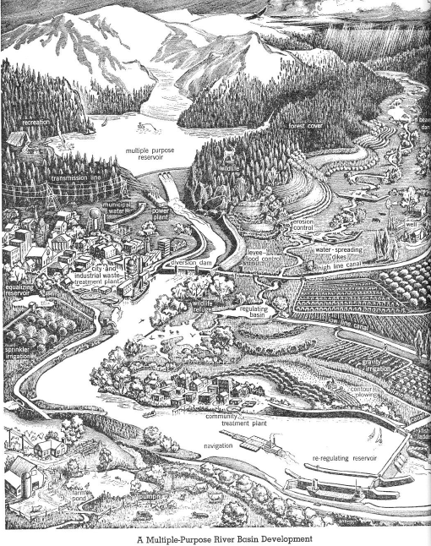
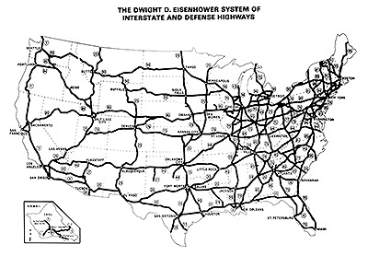
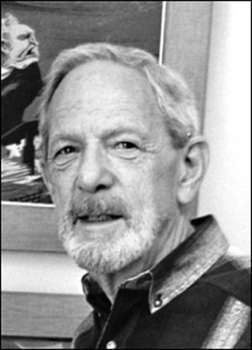
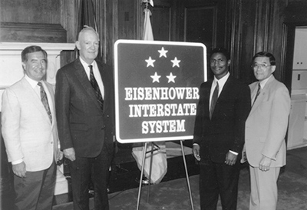
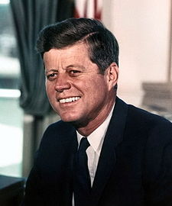
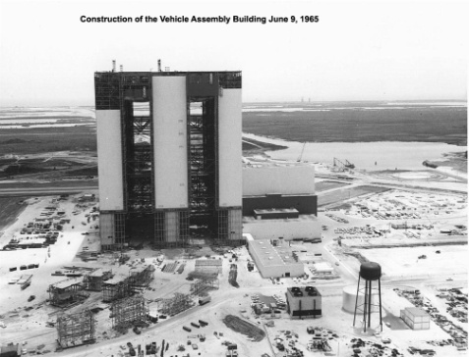
2b) Economic Efficiency: System Build-out
Analysis
1952 Circular A-47 Economic Analysis
1958 Multiple-Purpose River Development
1962 Design of Water Resources Systems
Key Legislation
1944, 1956, 1965 Flood Control Act
1948 and 1956 Water Pollution Control Acts
1955 and 1965 Rivers and Harbors Act
1956 Federal Aid Highway (Interstate) Act
1965 Water Resources Planning Act
1966 Clean Rivers Restoration Act
1968 Wild and Scenic Rivers Act
1968 Flood Insurance Act
Institutions Formed
1950 Presidential Water Resources Policy Cmsn
1952 House Subcommittee to Study Civil Works
1955 Pres. Cmsn on Water Resources Policy
1958 NASA
1965 Water Resources Council
Notes:
Summary from “The Evolution of Water Resource Planning and Decision-Making (Russell and Baumann 2009)
From: “A Multiple-Purpose River Basin Development”, A Water Policy for the American People The Report for the President’s Water Resources Policy Commission (1950) and Arthur Maass
Dwight Eisenhower and national system of interstate and DEFENSE highways
JFK: I believe that this nation should commit itself to achieving the goal, before this decade is out, of landing a man on the moon and returning him safely to the earth. No single space project in this period will be more impressive to mankind, or more important for the long-range exploration of space; and none will be so difficult or expensive to accomplish.

Slide 13
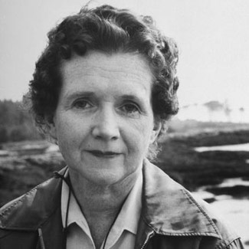
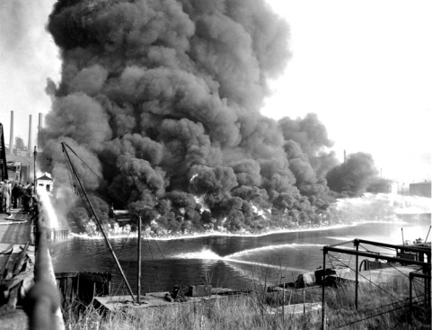
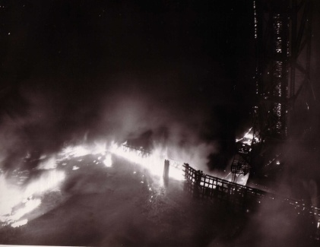
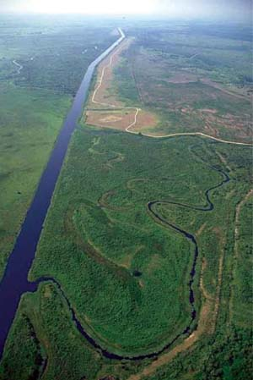
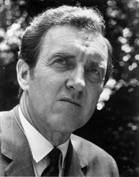

3) Environmental Enlightenment: Waking Up to Consequences
Analysis
1962 “Silent Spring” published
1973 National Water Commission report
Key Legislation
1969 National Environmental Policy Act
1973 Endangered Species Act
1974, 1986, &1996 Safe Drinking Water Acts
1977 Clean Water Act
1980 CERCLA
1986 Federal Power Act
1986 Water Resources Development Act
Institutions Formed
1970 Council on Environmental Quality
1970 Environmental Protection Agency
Key Events
1969 Cuyahoga River Catches Fire
1986 FEMA takes over Interagency Flood Management Task Force
1989 Escalating Federal involvement in Everglades restoration
Notes:
Summary from “The Evolution of Water Resource Planning and Decision-Making (Russell and Baumann 2009)
Cuyahoga River Fire in 1952 and again in 1969
Rachel Carson (Died 1964, but on leading edge of environmental movement)
Edmund Muskie was one of the first environmentalists to enter the Senate (1958-1976), and was a leading campaigner for new and stronger measures to curb pollution and provide a cleaner environment.

Slide 14


4) Emerging Focus? Adaptation and Resilience
White House Initiatives:
  “We Can’t Wait” Port Permitting
  Build America Investment
  Infrastructure Task Force
  Building a 21st Century Infrastructure
  Climate Action Plan
  Strengthen Global Resilience to Climate Change

Slide 15
John F. Kennedy:
The Last Great Positivist?
We are a great and strong country … but greatness and strength are not … gifts which are automatically ours forever. It took toil and courage and determination to build this country - and it will take those same qualities if we are to maintain it. For, although a country may stand still, history never stands still. Thus, if we do not soon begin to move forward again, we will inevitably be left behind. … But effort and courage are not enough without purpose and direction.

Slide 16




Influencing Water Resources Management
Investment Strategies
Leadership and Education
Governance
Disaster Management & Post Mortems
Technology and
Capacity
Notes:
Developed countries are more likely to think of environment and security in terms of global environmental changes; developing countries in terms of implications of local and regional problems.
This is not just politics. It is about values and what hundreds of millions of people actually need.
Our history and messages could help bridge the gaps between rich and poor on water resources and thus move implementation to help many in desperate need.

Slide 17
Changing Perspectives on Infrastructure
Adaptation & Resilience
Economic Efficiency
Environmental Enlightenment
Nation Building
Driving Forces
United States
Today
2010s
2000s
1980s
1960s
1940s
1920s
1900s
1800s
Agriculture - Food
Industrial - Manufacturing
Transportation
Energy - Hydrocarbon
Technology
~75% of the US population was born after 1960.
Less than 25%
of the population experienced the building of our nation’s key infrastructure
Other Emerging Powers
Investments
Enabling
Wear and Tear
Disabling
Hierarchy of Public Works Needs

Slide 18
The Value of Past Investments
An illustration of the relationship between services yielded by ecosystems, infrastructure, and the economic activities they support.
The value of natural and constructed systems was viewed as being greater than the sum of their intertwined parts, not only for the present generations, but also for those that would follow.
From: “A Multiple-Purpose River Basin Development”, A Water Policy for the American People The Report for the President’s Water Resources Policy Commission (1950)
Notes:
Here is an image depicting the services provided by a watershed and infrastructure that was put in place to support economic activity, to improve quality of life, and the reliability of services on which our communities presently rely.
It shows the relationships between our infrastructure, the environment, economic conditions, and the way of life we’ve come to enjoy as a result of prior generations’ investments. It also depicts facets of our daily lives that would be lost if we fail to secure the investments and sacrifices of prior generations for future generations.
This image was included in the 1950 report, A Water Policy for the American People The Report for the President’s Water Resources Policy Commission, and reflects a desire of our “Greatest Generation” to invest in the future of the nation, and to bestow on future generations of Americans a baseline of a platform of reliable services from which even greater potential might be realized.

Slide 19
Coasting on Past Investments
Approx $87B NED Annual Benefits
Notes:
Capital Stock consists of investments in water resources infrastructure built by the U.S. Army Corps of Engineers (USACE) from 1928 to 2011. (See bottom of Slide #1.) Based on the Perpetual Inventory Method, the value of capital stock (See bottom of Slide #1) increases with new investment and decreases as components deteriorate through time, reach the end of their service life and are retired.
The 2011 value of USACE capital stock is estimated at $191.4 billion, representing a decline of nearly 27 percent from its peak value in 1982
Capital stock value increased at an average of $5.35 billion per year from 1936 to its peak of $264.4 billion in 1982, then lost just over $2.4 billion annually between 1982 and 2011.

Slide 20


The Cost of Failure to Invest…
New Orleans:
Before … and … After
Pre-Katrina “System” 2005
50% complete after 50 years
$130 B in Recovery Costs
~ 1500+ Lives Lost
$14.6 B Post-Katrina System
Design & Constructed in 6 years
Successfully Performed during Hurricane Isaac
Notes:
The hurricane protection system in place in New Orleans on 29 August 2005 was really a system in name only. It had been in construction for ~ 50 years and was only 50 percent complete, constructed to different design standards and operated and maintained by a number of local agencies. The photo on left was taken in St. Bernard Parish the day Katrina hit...Katrina storm surge in that area was about 18 feet with 7 feet of waves.
Post-Katrina, the federal government spent $130 B in response and recovery efforts, including $14 B for a state-of-the-art risk reduction system.
The engineering effort that has evolved into what you see pictured on this slide is truly impressive and its appropriate to see how far we’ve come in defending New Orleans...to see these projects in person is even more impressive.
The IHNC Surge Barrier, pictured on the right side, is the largest surge barrier of its kind in the world, with three navigable gates that close in advance of a storm. Hard to tell from this photo, but it extends 26 feet ABOVE the water line It's 1.8 miles long, supported by massive concrete piles that are 144 feet long. The Surge Barrier won the 2012 Grand Conceptor Award from the American Council of Engineering Companies for the most outstanding engineering achievement.
As an example, the new storm reduction system takes into account both land subsidence and rising sea levels…one navigation gate that existed pre-Katrina is now 15 feet higher using the new methods for determining elevations needed to reduce risk from a 100-year storm.
Water resources infrastructure is long-lived. Because climate change impacts are increasing in severity over time, it is important to build-in flexibility to adapt to changing conditions when planning and designing new infrastructure and major rehabilitation projects.
It’s clear that preparing for changing conditions is more cost-effective in terms of life safety and economic investment than disaster response. As the World Economic Forum has pointed out, “A lack of investment now or investment in unsustainable areas will result in further costs through climate change.”
It is important that we recognize the risks associated with climate change and sea level rise and seek to plan proactively vice the highly expensive reactive response that both Katrina and Sandy demanded of us. Imagine if we can invest these dollars before the next disaster hits!

Slide 21


Hurricane Katrina vs. Hurricane Isaac
Katrina, 2005
Isaac, 2012
1,833 deaths
80% of New Orleans underwater
Widespread violence and looting – police diverted from rescue efforts
Spread of waterborne disease
1.7 million insurance claims for damaged/destroyed property
90,000 sq. mi. impacted
90% of New Orleans population evacuated
~130,000 people permanently settled elsewhere
5 deaths in U.S.
7,700 people evacuated
$2.35 billion in property damage
~1,000,000 homes without electric power
Notes:
In 2012, that system was put to the test as Hurricane Isaac hit the New Orleans area. A comparison of the after-effects of Isaac with what happened in Katrina 7 years earlier is amazing.

Slide 22


Hurricane Sandy
Landfall Oct. 29, 2012
Projected storm path
NOAA GOES-13 satellite image taken October 29, 2012 showing the storm centered off Maryland and Virginia

Slide 23



NJ Coastline During Sandy
Legend
With Project –
closer to point of landfall
Constructed
Authorized, Not Constructed
Study Phase
State Park
Inlet
30 miles apart
$1.9 B damages prevented
in communities with projects
Without Project
Notes:
In Sandy it wasn’t about massive floodwalls, although they might’ve helped in some areas, it was about coastline protection and risk reduction.
Sea levels have risen and continue to rise so we must be concerned about these climate change related effects, as we consider ways to reduce this risk in the future.
Tell NJ Gov. Christie story---Gov. Christie publicly has said this about the Jersey Shore during Sandy: "the towns that had significant engineered dune systems suffered significantly less damage than the ones that had no dunes, so we know that these dunes systems now work. So really they’re the difference between catastrophic damage and little or no damage.”
137 miles of total coastline; 15 coastal projects authorized; 9 projects with funding appropriated; 9 under construction /completed; All 9 locations received minimal coastal damage during SS Sandy
During Hurricane Sandy
Task Force Dewater pumped 475M gallons of water from the NYC metro area; 86M of this was from the Brooklyn Battery Tunnel the longest continuous underwater vehicular tunnel in North America…enough to fill the Rose Bowl Stadium to its top
- Task Force Power provided 54 MW of power, installed 211 generators in NY/NJ, providing temporary power generation to 25,000 residents.
NJ Coastal projects from NAP office. Top Photo: Brant Beach, NJ, Bottom Photo: Mantoloking, NJ

Slide 24
Reducing Risk, A Shared Responsibility
Initial Risk
Absolute protection from floods is not possible – we must plan for exceedence (Residual Risk)
We cannot rely on a single structural approach – we must implement a portfolio of measures
Zoning
Risk
Notes:
Major point to be made here is that resilience is not a one-person job. Individuals play a major role, as do local governments, insurance companies, the States, and a variety of Federal agencies.

Slide 25

U.S. Ports and Inland Waterways:
Vital to intermodal transport
Seattle
Anacortes
Tacoma
Kalama
Portland
Two Harbors
Duluth/Superior
Portland
Boston
Detroit
Chicago
Pittsburgh
New York/NJ
Richmond
Indiana Hbr
Toledo
Cleveland
Lower Delaware
River (9 harbors)
Oakland
Cincinnati
Baltimore
St. Louis
Huntington
Hampton Roads
Los Angeles
Million
Tons
Memphis
Long Beach
Over 100
Baton Rouge
Charleston
50 - 100
Lake Charles
Pascagoula
Savannah
25 - 50
Houston
Jacksonville
Texas City
Mobile
Tampa
10 - 25
Freeport
Port Arthur
Plaquemines
Matagorda
Beaumont
New Orleans
Port Everglades
Corpus Christi
S. Louisiana
Valdez
Barbers Pt
Honolulu
Notes:
Surface Transport Data from Sources: Highways: U.S. Department of Transportation, Federal Highway Administration, Freight Analysis Framework, Version 3.4, 2012. Rail: Based on Surface
Transportation Board, Annual Carload Waybill Sample and rail freight flow assignments done by Oak Ridge National Laboratory. Inland Waterways: U.S. Army Corps of
Engineers (USAGE), Annual Vessel Operating Activity and Lock Performance Monitoring System data, as processed for USAGE by the Tennessee Valley Authority; and USAGE,
Institute for Water Resources, Waterborne Foreign Trade Data, Water flow assignments done by Oak Ridge National Laboratory.
Much of the Corps’ Civil Works program centers around WATER – navigation, water supply, ecosystem restoration, flood risk management, regulatory, recreation.
Need to work together to tell the story of the value of our Ports and Inland Waterways…
China exports $1.9 trillion annually and imports $1.7 annually.
U.S. Waterways (Source: AAPA):
U.S. ports and waterways handle more than 2 billion tons of domestic and import/export cargo annually.
By 2020, the total volume of cargo shipped by water is expected to be double that of 2001 volumes.
$3.8 billion worth of goods moving in and out of U.S. seaports each day
Over 300 million cubic yards of dredged material are removed from navigation channels each year. Another 100 million cubic yards are dredged from berths and private terminals. The total, 400 million cubic yards of dredged material, equals a four-lane highway, 20 feet deep, stretching from New York City to Los Angeles.
Seaports support the employment of more than 13 million people in the U.S.
Inland Waterways (Source: WCI)
Nearly 12,000 miles of navigable channels
196 lock sites / 241 chambers
624 million tons of cargo annually at a value of nearly $70 billion
14% of the nation’s domestic freight
60% of nation’s grain exports, 20% of coal, 22% of domestic petroleum and petroleum products

Slide 26

Resilience: A (recent) Growth Industry
Many agencies and NGOs are seeking to develop resilient systems
Most studies of resilience have focused on ecology & communities
60 definitions of resilience since late 1970s
USACE developing methods to quantify resilience
“Is resilience in danger of becoming just another
buzzword? Does its malleability mean that many divergent measures, including those that might otherwise appear indefensible, can be justified in the name of resilience? Or, is it a promising concept for planning theory and practice? And if so, what are the opportunities and limitations of translating resilience from the field of ecology into planning?” (USACE will include design and operations
in addition to planning)
Notes:
The USACE has been leading an effort to quantify resilience, and we’ve found…
Many federal and non-govermental offices are seeking to develop resilient systems, but all of these efforts discuss resiliency in a qualitative manner.
Most of the definitions we’ve found concern ecological and community systems…very few evaluate engineering structures and how those serve the community. We’ve looked at 60 definitions of the term that have been documented since the late 1970s.
We have a method that we are testing to quantify resilience.
A recent (2012) special issue of Planning Theory & Practice took the issue of resilience head-on, by first addressing the issue of the many uses and meanings of the term, and asking whether it has just become another buzzword. In the end, they provide a number of perspectives about resilience and conclude that it’s here to stay, though “it is paramount that we continue asking critical questions...”

Slide 27

Key Messages for Urban Systems, Infrastructure, and Vulnerability
National economy, security, and culture all depend on the resilience of urban infrastructure systems
  Essential infrastructure systems will increasingly be compromised
  Disruptions of services in one infrastructure system will almost always result in disruptions in one or more other systems
Urban climate vulnerability and adaptive capacity are influenced by pronounced social inequalities
Preparedness and resilience requires cooperative private sector and governmental activities
Notes:
The third National Climate Assessment for the US, just released in May 2014, reports that climate change and its impacts threaten urban residents, with the following key messages:
Essential infrastructure systems such as water, energy supply, and transportation will increasingly be compromised by interrelated climate change impacts.
In urban settings, climate-related disruptions of services in one infrastructure system will almost always result in disruptions in one or more other infrastructure systems.
The nation’s economy, security, and culture all depend on the resilience of urban infrastructure systems.
The vulnerability and adaptive capacity of urban residents are threatened by pronounced social inequalities, such as differences in age, ethnicity, gender, income, health, and (dis)ability.
City government agencies and organizations have started adaptation plans that focus on infrastructure systems and public health. To be successful, these adaptation efforts require cooperative private sector and governmental activities, but institutions face many barriers to implementing coordinated efforts.

Slide 28

The Cycle of Resilience
Notes:
We know we are not going to stop hurricanes and other natural disasters, so we want to minimize the impacts. Hx Katrina helped to advance how we look at and now quantify risk and risk reduction. In the aftermath of Hx Sandy the concept of resilience has significantly influenced how we are thinking about project and regional response. To use resilience as criteria in our design and operations, we have to advance and quantify it.
Coastal Infrastructure Resilience (including engineering, ecological, and community):
The ability of a system* to anticipate (prepare, avoid), resist (withstand), recover (bounce back), and adapt (evolve, transform) to achieve functional performance under the stress of disturbances.
Quantified as the joint probability of achieving two objectives (Schultz et al. 2012):
Functional (design) objective (e.g., 100-year CSDR)
Recovery (temporal) objective (e.g., operational 1 week after disturbance)
*System defined in context of…
…components of a project
…a specific project
…reinforcing and inter-related projects within a watershed
…USACE operations – Planning, Design, O&M – in which the USACE anticipates, monitors, and prepares for resilient systems
…ecosystem and communities within the watershed
Keys to Definition:
Emphasis on Functional Performance
Holistic (system-scale) approach
Considers intermittent (storms, tsunamis, earthquakes) and long-term changes (sea level change, changes in precipitation patterns)
Two user-specified objectives: (1) performance (function; design goal) and (2) time scale for recovery

Slide 29
Concepts of Coastal Resilience (2 of 4)
Rebuilding, new projects, community awareness, etc.
Disturbance
Disturbance
Adapt; Evolve
100%
Prepare;
Anticipate
Resist;
Withstand
Functionality
Recover
Bounce Back
Resilience increased:
Less loss in functionality
Faster recovery time
0%
Time
Charge
Plan & Approach
Concepts
Pilot
Strategy
R&D Needs
Spiral Plan

Slide 30
















Concepts of Coastal Resilience (3 of 4)
Integrated Coastal Resilience is realized via a combination of Engineering, Environmental, and Community resilience
Engineering
Environmental
Community
State &
Local
Govt
Charge
Plan & Approach
Concepts
Pilot
Strategy
R&D Needs
Spiral Plan

Slide 31


Concepts of Coastal Resilience (4 of 4)
Resilience: the ability of a system to Prepare for, Resist, Recover, and Adapt to achieve functional performance under the stress of disturbances through time.
Study | Definition
NAS (2012) | “Resilience is the ability to prepare and plan for, absorb, recover from, and more successfully adapt to adverse events.”
E.O. 13653 (2013) | "resilience means the ability to anticipate, prepare for, and adapt to changing conditions and withstand, respond to, and recover rapidly from disruptions.”.
Engineering
Environmental
Community
Charge
Plan & Approach
Concepts
Pilot
Strategy
R&D Needs
Spiral Plan

Slide 32

Pilot Study in Jamaica Bay
Test two analyses to calculate present-day resilience
General Assessment: Rapid method based on expert elicitation
  Detailed Assessment: Rigorous method via probabilistic analyses; appropriate for design
Charge
Plan & Approach
Concepts
Pilot
Strategy
R&D Needs
Spiral Plan
32

Slide 33
Integrated Management: Resilience Matrix Approach
Good
Moderate
Low
Goal:
Provide baseline assessment for intercomparing project alternatives
Approach:
Define extent of system & potential disturbances
Identify function(s) to be evaluated; for Jamaica Bay:
  Ecosystem health
  Housing/shelter
Assess via expert elicitation* capacity of each cell in matrix
Results indicate:
  Gaps in system resilience
  Project needs
  Partner roles
→ Detailed assessment focused on Housing & Shelter
Jamaica Bay
Ecosystem Health | Prepare | Resist | Recover | Adapt
Physical System
Data & Analysis
Decision Support |  | n/a
Communication
Housing and Shelter | Prepare | Resist | Recover | Adapt
Physical System
Data & Analysis
Decision Support
Communication
*Query experts; review literature; examine historical record
POCs: Cate Fox-Lent, Igor Linkov, ERDC-EL
Charge
Plan & Approach
Concepts
Pilot
Strategy
R&D Needs
Spiral Plan
33

Slide 34



Resilience: Integrated Approach
History of Integrated Approaches
  Ohio River Canalization
    1875 - Present
  1927 Flood →Jadwin Report
    1928 FCA = MR&T
  Peck-Sloan Plan
    Missouri River Dams
  SuperStorm Sandy → NACCS
    Anticipate a changing environment
    Integrate economic, social, and environmental resiliency and sustainability
    Promote long term community protection
Notes:
USACE has long recognized the value of integrated approaches to risk reduction incorporating natural and nature-based features in addition to nonstructural and structural measures.
Two examples are the Jadwin Report after the flood of 1927, and the Mississippi Coastal Improvement Project after Hurricane Katrina.
A third is the joint NOAA-USACE Sandy Infrastructure Systems Rebuilding Principles.
Mention also the NACCS and recent NRC report

Slide 35


Ongoing and Future Challenges
Coping with new understandings of climate variability and risks of water- related disasters?
Integrating hard infrastructure with soft behavioral approaches?
Managing ecosystems while still allowing socio-economic growth?
Including broad ranges of stakeholders brought into the process?
Building new capacity to achieve water security?
Preparing and investing in the future?

Slide 36



Infrastructure Systems Rebuilding Principles
Work together to develop long-term strategies
Improve coastal resilience
Increase awareness of risks and consequences
Artificial image
Notes:
But while we talk about withstanding the effects of a major event, we should also talk about recovery. Our experience with Sandy brought home these 3 principles, which I’ll elaborate in the next 3 slides

Slide 37
Principle 1: Work Together to Develop Long-Term Strategies
Involve stakeholders in scoping, development, implementation, and monitoring of integrated solutions.
Work across the Federal government to promote alignment of agency actions.
Leverage partnerships to maximize all appropriate sources of funding, resources, and expertise.
Work with State and local partners to sequence and focus rebuilding and restoration.
Align and deliver data, tools, and information (e.g., physical, ecological, economic, etc.) in easily accessible formats.
Ensure the Federal government provides useful and timely technical assistance and information.
Learn from the experience of Superstorm Sandy by conducting assessments of what worked and what did not.
Promote public safety.
Protect and restore natural resources and functions of the coast.
Enhance coastal resilience
Notes:
The first principle, work together, to develop long-term strategies, involves stakeholders in scoping, development, implementation, and monitoring of integrated solutions that leverage partnerships to maximize all appropriate sources of funding, resources, and expertise.

Slide 38
Principle 2: Improve Coastal Resilience
Promote integration of natural and built systems.
Use adaptive management to encourage flexible decision-making.
Seek to modify critical infrastructure in response to changing conditions.
Advance understanding of a system-based approach and the benefits of the natural environment and its “services,” including coastal buffering.
Support sustainable economic activities and strengthening of existing social institutions.
Identify economically-viable solutions that minimize impacts to the natural functions of floodplains and coastal ecosystems.
Work together to identify priority actions on a system or subsystem basis.
Align investments to ensure that water dependent uses of the coast, particularly ports and related infrastructure, support working waterfronts that are more efficient, safe, secure, resilient, and environmentally sustainable.
Artificial image
Notes:
The second principle, improve coastal resilience, promotes integration of natural and built systems, with adaptive management to encourage flexible decision-making. This requires that we improve understanding of a system-based approach and the benefits of the natural environment and its “services,” support sustainable economic activities and strengthening of existing social institutions, nd align investments to ensure that water dependent uses of the coast, particularly ports and related infrastructure, support working waterfronts that are more efficient, safe, secure, resilient, and environmentally sustainable.

Slide 39
Principle 3: Increase Awareness of Risks and Consequences
Improve understanding among decision makers.
Encourage risk-informed decisions that consider uncertain changes in the natural and built environments, including the effects of climate change, land-use change, and coastal development.
Invest in risk communication efforts, including disclosure of risks that have not or cannot be mitigated in an economically feasible manner.
Encourage coordination of, and common approaches to characterization of risks, vulnerabilities, and mitigation strategies.
Develop and share user-friendly information and tools for assessing impacts, managing risks, and risk/reward tradeoffs related to different project options.
Notes:
The third principle, increase awareness of consequences and risk, requires us to improve understanding among decision makers to encourage risk-informed decisions that consider uncertain changes in the natural and built environments, including the effects of climate change, land-use change, and coastal development. We also need to invest in risk communication efforts, including disclosure of risks that have not or cannot be mitigated in an economically feasible manner and develop and share user-friendly information and tools for assessing impacts, managing risks, and risk/reward tradeoffs related to different project options.

Slide 40

NACCS Coastal Storm Risk Management Framework

Slide 41

Summary
The resilience of coastal infrastructure systems will increasingly be compromised by climate in addition to other agents of change
BUT …
Resilience is possible when diverse groups come together to create new ideas and new combinations of ideas, as is being done in many forums, including this one
Notes:
In summary, we know that essential urban infrastructure systems such as water, energy supply, and transportation will increasingly be compromised by interrelated climate change impacts.
In urban settings, climate-related disruptions of services in one infrastructure system will almost always result in disruptions in one or more other infrastructure systems.
We’ve got to consider the interconnected nature of these systems, and especially the critical infrastructure underground and at or near the water surface.
On the plus side, the diverse groups that are developing new ideas and inventive ways to combine different approaches, and capitalize on existing infrastructure, are developing just the kinds of information we need to help evolve and transform urban areas in a way that enhances resilience.
The challenge we have is how to peel back the layers of a city and its social and infrastructure networks to help us understand how to move to a new state. Forums such as this one help us accomplish this challenge.

Slide 42


Thank You!
US Army Corps of Engineers
BUILDING STRONG®

